Slide 1

HIGH EFFICIENCY FOR LOW-INCOME PROGRAM (HELP)
AEP Ohio HELP Program
2026 Training
January | 27 | 2026

Slide 2
AGENDA
Program Manual Changes
Measure Eligibility & Requirements Review
Program Application Review & Assessment Scheduling
Assessment Review & Best Practices
eSuite Process Flow Review
eSuite Measure Entry Review
eSuite New Features
Program Resources
2026 Expectations & Next Steps
Questions & Feedback
– Break (10 min) –

Slide 3
KEY PROGRAM CONTACTS
Deanna Gilliland
AEP Ohio – EE & Consumer Programs Manager
dmgilliland@aep.com
614-935-3120
Dylan Matthews
Resource Innovations – Solution Delivery Director
Dmatthews@resource-innovations.com
773-415-8239
Dani Kissel
Resource Innovations – Solution Delivery Lead
Dkissel@resource-innovations.com
513-207-8420
Tim Petrides
Resource Innovations – Market Engagement Lead
tpetrides@resource-innovations.com
614-929-8269
Christine Greene
Resource Innovations – Solution Delivery Coordinator
cgreene@resource-innovations.com
614-327-9464
David Richard
Resource Innovations – Solution Delivery Manager
drichard@resource-innovations.com
614-849-2483

Slide 4
PROGRAM MANUAL CHANGES

Slide 5
Program Goals & Updates
2026 Program Goals & Incentive Budget:
Program updates are highlighted in yellow throughout this presentation
All program changes reviewed today will take effect Monday February 2nd, 2026
  This includes all newly offered program measures
Assessments completed before this date will be grandfathered in under the previous program guidelines
  100% CAP & SLP retrofit project cost coverage for assessments completed prior to 02/02/2026
  Measure eligibility requirements
 | Savings (kWh) | Peak Demand Reduction (kW) | Incentive Budget
2026 HELP Total | 8,000,000 | 1,800 | $7,685,900

Slide 6
PROGRAM QUALIFYING ENERGY CONSERVATION MEASURES
Eligible customers will receive the following services at no cost:
Eligible customers will receive the following services at no cost or a discounted rate:
Walkthrough Home Energy Assessment to identify both energy saving measures and health and safety opportunities
Direct installation of low-cost energy saving devices during the assessment:
  Specialty LED light bulbs
  Tier 2 smart power strips
  Faucet aerators
  Showerheads
  Pipe wrap
  Wi-Fi Enabled Smart Thermostat
  Air purifier / cleaner replacement
  Dehumidifier replacement
  Water heater tank wrap
  Door sweeps
Follow-up installation of home energy efficiency measures:
  Replacement of central air conditioner with air source heat pump (electric heat only)
  Heat pump water heater
Follow-up installation of home energy efficiency measures:
  Refrigerator Replacement (top freezer, bottom freezer, side by side, & french door units)
  Freezer Replacement
  Air sealing
  Duct sealing
  Insulation (attic, floor, wall, basement / sidewall, & rim joist)
  Clothes Washer Replacement
  Heat Pump Clothes Dryer Replacement
  All-in-One Clothes Washer-Dryer Replacement
  Ceiling Fan Replacement
Health and safety cost support

Slide 7
DIRECT INSTALL MEASURE INCENTIVES
Measure Name | Unit | Measure Cost per Unit | Labor Cost per Unit | Total Incentive Per Unit Installed
Advanced Smart (Tier 2) Power Strip | Each | $52.00 | $10.00 | $62.00
LED Outdoor Flood Light Fixture | Each | $7.00 | $10.00 | $17.00
LED BR30 | Each | $4.00 | $10.00 | $14.00
T8 LED | Each | $5.00 | $10.00 | $15.00
Globe LED | Each | $3.00 | $10.00 | $13.00
Candelabra LED | Each | $2.50 | $10.00 | $12.50
MR16GU10 | Each | $3.00 | $10.00 | $13.00
Specialty LED (other) | Each | $5.00 | $10.00 | $15.00
Kitchen Low Flow Aerator | Each | $2.50 | $13.00 | $15.50
Bathroom Low Flow Aerator | Each | $1.50 | $13.00 | $14.50
*Measure cost per unit based on Procurement Portal

Slide 8
DIRECT INSTALL MEASURE INCENTIVES
Measure Name | Unit | Measure Cost per Unit | Labor Cost per Unit | Total Incentive Per Unit Installed
Fixed Low Flow Showerhead | Each | $7.00 | $13.00 | $20.00
Handheld Low Flow Showerhead | Each | $19.00 | $13.00 | $32.00
Fixed Showerhead with TSV | Each | $29.00 | $13.00 | $42.00
Evolve ShowerStart with TSV3 | Each | $29.00 | $13.00 | $42.00
Pipe Wrap (Hot Water) | Foot | $0.56 | $13.00 | $13.56
Wi-Fi Enabled Smart Thermostat | Each | $100.00 | $80.00 | $180.00
ENERGY STAR Air Purifier / Cleaner Replacement | Each | $75.00 | $13.00 | $88.00
ENERGY STAR Dehumidifier | Each | $180.00 | $20.00 | $200.00
Water Heater Tank Wrap | Each | $50.00 | $15.00 | $65.00
Door Sweeps | Each | $5.00 | $10.00 | $15.00
*Measure cost per unit based on Procurement Portal

Slide 9
RETROFIT MEASURE INCENTIVES
Additional Measures
HELP offers several other premium incentives for other savings opportunities. During the assessment, HELP Home Energy Assessors may identify more complex measures for the customer to consider. These measures are not expected to be completed during the site assessment. If the customer is interested in receiving any of these additional measures, the HELP program will assign an in-network contractor to complete the work.
Retrofit Measure Name | Unit | Measure Cost | Labor Cost | CAP Incentive per Unit (100% of Cost)¹ | SLP Incentive per Unit (100% of Cost)¹
ENERGY STAR Heat Pump* | Each | $11,500.00 | $3,500.00 | $15,000.00 | $15,000.00
ENERGY STAR Mini Split Heat Pump* | Each | $16,500 | $3,500.00 | $20,000.00 | $20,000.00
ENERGY STAR Heat Pump Water Heater* | Each | $4,500.00 | $500.00 | $5,000.00 | $5,000.00
¹All retrofit costs will be reviewed prior to program approval to proceed
*Measure costs for heat pump, mini-split heat pump, & heat pump water heater are an average, actual costs and rebates will vary from project to project. Submit recommendation and price quote for preapproval to assess program coverage.

Slide 10
RETROFIT MEASURE INCENTIVES
Retrofit Measure Name | Unit | Measure Cost | Labor Cost | Total Incentive | CAP Incentive per Unit (90% of Cost) | SLP Incentive per Unit (65% of Cost)
ENERGY STAR Refrigerator Replacement 20-22 Top Freezer (includes icemaker if required) | Each | $890.00 | $225.00 | $1,115.00 | $1,003.50 | $724.75
ENERGY STAR Refrigerator Replacement 19-22 Bottom Freezer (includes icemaker if required) | Each | $1,150.00 | $225.00 | $1,375.00 | $1,237.50 | $893.75
ENERGY STAR Refrigerator Replacement 20-23 Side by Side or French Door (always includes icemaker) | Each | $1,300.00 | $225.00 | $1,525.00 | $1,372.50 | $991.25
ENERGY STAR Refrigerator Replacement 24-26 Side by Side (always includes icemaker) | Each | $1,325.00 | $225.00 | $1,550.00 | $1,395.00 | $1,007.50
ENERGY STAR Refrigerator Replacement 24-26 French Door (always includes icemaker) | Each | $1,500.00 | $225.00 | $1,725.00 | $1,552.50 | $1,121.25
ENERGY STAR Heat Pump Clothes Dryer | Each | $1,500.00 | $200.00 | $1,700.00 | $1,530.00 | $1,105.00
*Previously offered 27-28 cu. ft. French Door refrigerator replacements will no longer be included as an eligible measure due to cost effectiveness. Customers with this size and style unit may be eligible for replacement if they are willing to downsize to a 24–26 cu. ft. French door refrigerator.

Slide 11
RETROFIT MEASURE INCENTIVES
Retrofit Measure Name | Unit | Measure Cost | Labor Cost | CAP Incentive per Unit (100% of Cost) | SLP Incentive per Unit (65% of Cost)
Home that has air sealing performed | ∆100 CFM | $300.00 |  | $300.00 | $195.00
Sealed duct in unconditioned spaces* | ∆25 CFM | $200.00 |  | $200.00 | $130.00
Attic insulation | 100 SQ FT | $200.00 |  | $200.00 | $130.00
Floor insulation | 100 SQ FT | $400.00 |  | $400.00 | $260.00
Wall insulation | 100 SQ FT | $300.00 |  | $300.00 | $195.00
Basement / sidewall insulation | 100 SQ FT | $200.00 |  | $200.00 | $130.00
Rim joist insulation | 100 SQ FT | $450.00 |  | $450.00 | $292.50
ENERGY STAR Freezer Replacement | Each | $675.00 | $225.00 | $900.00 | $585.00
ENERGY STAR Ceiling Fan | Each | $225.00 | $125.00 | $350.00 | $227.50
ENERGY STAR All-in-One Clothes Washer-Dryer | Each | $2,300.00 | $200.00 | $2,500.00 | $1,625.00
ENERGY STAR Clothes Washer | Each | $1,000.00 | $200.00 | $1,200.00 | $780.00
*Duct Sealing will receive an $800 minimum incentive for projects reducing less than 100 CFM

Slide 12
HELP PROGRAM ENERGY ASSESSMENT FEE
In addition to the measure and labor incentives, HHEAs and Installation Contractors will receive payments for conducting in-home energy assessments based on the residence’s water heating and fuel type. The payment structure is outlined as follows:
A $25 additional payment will be provided for site assessments located more than 20 miles from the HHEA/Installation Contractor office (main or satellite).
A $400 Contractor Inspection Fee will be provided for air sealing, duct sealing, or insulation “non-projects” to ensure you are compensated for your time and travel. Non-projects are situations where a visit is scheduled but work cannot be completed due to site conditions or eligibility requirements. Successful reductions or installations will receive standard incentive payments as outlined on slide 11.
 | Residence Heating Fuel Type | Residence Water Heating Type | Home Energy Assessment Payment
1 | Electric | Electric | $325.00
2 | Electric | Natural Gas | $310.00
3 | Natural Gas | Electric | $310.00
4 | Natural Gas | Natural Gas | $300.00

Slide 13
HELP ASSESSMENT INCENTIVE PAYMENT EXAMPLE
[Electric heat & water residence]
 | Averages per Assessment
Measure | Installed Units | Measure Incentive | Labor Incentive | Total Incentive
Assessment Fee |  |  | $325.00 | $325.00
Advanced Smart (Tier 2) Power Strip | 1 | $52.00 | $10.00 | $62.00
LED Outdoor Flood Light Fixture | 1 | $7.00 | $10.00 | $17.00
Globe LED | 3 | $9.00 | $30.00 | $39.00
Kitchen Low Flow Aerator | 1 | $2.50 | $13.00 | $15.50
Fixed Low Flow Showerhead | 1 | $7.00 | $13.00 | $20.00
Pipe Wrap (Hot Water) | 3’ | $1.68 | $39.00 | $40.68
TOTAL | 8 | $79.18 | $440.00 | $519.18
Site Visit Timing
Walkthrough: 30 Min
Meet w/ Homeowner: 10 Min
Direct Installs: 100 Min
Program Data Entry: 20 Min
Total Est. Time: 160 Min
+
=
Labor Payment per Assessment
Assessment Fee: $325
+ Approx. Labor Incentive: $115
Avg. Labor Payment: $440
(Approx. Hourly Rate): ($165/hr)

Slide 14
Program Braiding
Braiding funds with other non-AEP Ohio programs is permitted, provided the other program does not claim kWh savings.
  This prevents double-counting of energy savings and ensures regulatory compliance
This allows HELP program assessment fees and incentives for installed measures to be combined with incentives from another program for the same installed measures.
For example, the following programs can be braided with HELP program funds:
  EPP
  HWAP
  Columbia Gas Warm Choice
  Community Housing Improvement Program (CHIP)

Slide 15
MEASURE REQUIREMENTS – DIRECT INSTALLS

Slide 16
Direct Install Measure Requirements
 | Advanced Smart Tier 2 Power Strip
Residence Requirements | Electric or Non-Electric Water Heating | Electric or Non-Electric Space Heating
Measure Eligibility | Existing power strip must not include power-saving features
Measure Requirements | Must replace existing high use power strips or be installed in high use outlets such as in entertainment centers or home offices
Limits | 1 per household
 | Energy Star® LED Specialty Bulbs
Residence Requirements | Electric or Non-Electric Water Heating | Electric or Non-Electric Space Heating
Measure Eligibility | Existing bulbs must be incandescent or T8/T12 fluorescent tubes in high-use areas (average of 2 hours per day) Lamps in permanent fixtures are eligible for replacement. Lamps in portable fixtures are eligible for replacement if there is no permanent fixture in the room and they are the main light source. Burnt out lamps or empty sockets may be replaced by an equivalent LED bulb to the burnt-out bulb, or to the wattage rated for the fixture. Bulbs in closets, storage rooms, or exterior fixtures are not eligible. Hallway fixtures are not typically designated as high-use areas.
Measure Requirements | Replacement LED bulbs will meet the following requirements: Lumen output: must be equivalent to that of the bulb the socket is rated to be installed Rated Life: 15,000 hours Efficacy: 61 lumens per watt (LPW) for directional, and 65 LPW for decorative lights CRI minimum: 80 A19 bulbs are not eligible measures under the program and may not be installed or replaced, regardless of bulb type or base Replacing existing LED fixtures with new LED fixtures is not eligible.
Limits | 18 per household

Slide 17
Direct Install Measure Requirements
 | LED Outdoor Flood Lights
Residence Requirements | Electric or Non-Electric Water Heating | Electric or Non-Electric Space Heating
Measure Eligibility | Existing bulbs must be incandescent/halogen in applications likely to have a minimum use of two hours per day.
Measure Requirements | Replacement LED Outdoor Flood Light must be an LED PAR30 with a wattage between 15W and 18W. Replacement units are available for front and back porch lights, and garage lights. Replacement units will reduce wattage by a minimum of 20%.
Limits | 4 per household
 | Low Flow Showerhead
Residence Requirements | Electric Water Heating
Measure Eligibility | Existing showerhead must be a standard showerhead with flow of 2.0 GPM or greater.
Measure Requirements | Replacement units will have a flow of 1.5 GPM or less at 80 PSI.
Limits | 2 per household (regardless of showerhead type)
 | Standard Flow Showerhead with TSV
Residence Eligibility | Electric Water Heating
Measure Eligibility | Existing showerhead must be a standard showerhead
Measure Requirements | Replacement unit’s thermostat will be 95 degrees or lower.
Limits | 2 per household (regardless of showerhead type)

Slide 18
Direct Install Measure Requirements
 | Low Flow Aerator
Residence Requirements | Electric Water Heating
Measure Eligibility | Homes eligible to receive a low flow aerator must have a standard aerator with flow of 2.2 GPM or greater.
Measure Requirements | Replacement units will have a flow of 1.5 GPM or less.
Limits | 3 per household
 | Pipe Wrap Insulation
Residence Requirements | Electric Water heating
Measure Eligibility | Pipe wrap insulation is only available for exposed hot water pipes with no previous insulation. Existing insulation that is worn or torn is not eligible for replacement.
Measure Requirements | Pipe insulation will be taped or glued at all joints.
Limits | Limited to 15’ total
 | Energy Star® Air Purifier
Residence Requirements | Electric or Non-Electric Water Heating | Electric or Non-Electric Space Heating
Measure Eligibility | Home must have an existing Air Purifier that is in use
Measure Requirements | Replacement unit must be Energy Star certified and the same size or smaller than the unit being replaced.
Limits | 1 replacement per household

Slide 19
Direct Install Measure Requirements
 | *Wi-Fi Enabled Smart Thermostat
Residence Requirements | Electric Heating | Central AC
Measure Eligibility | Homes are not required to have Wi-Fi to be eligible for this measure. Existing programmable thermostats are eligible if not currently set to a schedule.
Measure Requirements | Replacement units must be one of the approved models listed in the table below Replacement units are required to be programmed with either the homeowner or landlord/management organization. Determine a set point for occupied hours For unoccupied hours, the temperature set point must be: ≥ 3°F warmer than the occupied set point in the summer, and ≤ 3°F cooler in the winter.
Limits | 1 per household
*If customer is eligible for a new HVAC system, the Wi-Fi-enabled smart thermostat will be installed during the follow-up visit, in coordination with the HVAC installation.
*Approved Wi-Fi Enabled Smart Thermostats
Pelican TS200 TS200H TS250 TS250H | Sensi Sensi Lite Smart Thermostat Sensi Touch 2 Smart Thermostat Sensi Touch Smart Thermostat (Silver) Sensi Touch Smart Thermostat (White) Sensi Smart Thermostat |  | Google Nest Google Nest Learning Thermostat Google Nest Thermostat Google Nest Thermostat E
Ecobee Ecobee3 Ecobee3 Lite Ecobee 4 Ecobee Smart Thermostat Ecobee Smart Thermostat with Voice Control Ecobee Smart Thermostat Premium Ecobee Smart Thermostat Enhanced | Honeywell Home Lyric TH6220WF2006 TH6320WF2003 RCHT8610WF2006 RCHT8610WF2014 RCHT8610WF3005 | RCHT8612WF2005 RCHT8612WF2015 RCHT9510WFW2001 RCHT9510WFW2017 RCHT | Honeywell TH8110R1008 TH8320R1003 TH8321R1001 YTH8321R1002 TH8321WF1001 YTH8321WF1036 TH9320WF5003 9421R5021WW | YTHX9421R5085WW YTHX9421R5127WW YTHX9421R7001WW YTHX9421R5101WW RTH9585WF1004 RTH9585WF1012 TH6320WF1005 RTH6580WF1001 | RTH6580WF1006 RTH8580WF1004 RTH8580WF1007 RTH9580WF1005 RTH9580WF1013 RTH9580WFKITHQ RET97A5E1001

Slide 20
Direct Install Measure Requirements
 | Water Heater Tank Wrap
Residence Requirements | Electric Water Heating
Measure Eligibility | Homes eligible to receive tank wrap must have an existing electric tank style water heater located in conditioned or unconditioned space with an insulation value < 10.
Measure Requirements | Tank wrap must be 3” thick Aluminum tape or nylon wraps must be used to secure tank wrap. Manufacturer’s instructions for wrapping tank are to be followed.
Limits | 1 per household
 | Door Sweeps
Residence Requirements | Electric space heating
Measure Eligibility | Door sweeps must be installed between conditioned and unconditioned space
Measure Requirements | Applies to existing doors only Doors to small spaces such as closets and pantries are not applicable
Limits | No limit
 | Energy Star® Dehumidifier
Residence Requirements | Electric or Non-Electric Water Heating | Electric or Non-Electric Space Heating
Measure Eligibility | Home must have an existing Dehumidifier that is in use
Measure Requirements | Replacement unit must be Energy Star certified and the same size or smaller than the unit being replaced.
Limits | 1 replacement per household

Slide 21
MEASURE REQUIREMENTS – RETROFITS

Slide 22
Retrofit Measure Requirements
 | Air Sealing
Residence Requirements | Electric Space Heating | Electric Cooling System (Central AC, Room AC, or Heat Pumps)
Measure Requirements | Air sealing will be completed by properly certified personnel (BPI or equivalent). All accessible areas of the attic, floor, and exterior penetrations will be sealed. Additional air sealing measures may include door sweeps and seals, caulking around window and door openings, and outlet gaskets. Pre- and post-blower door tests will be performed on all air-sealed units. In single family homes, air sealing will be performed in conjunction with the attic insulation measure if existing insulation is insufficient. In multifamily homes, air sealing is recommended to be performed in conjunction with attic insulation measures if existing insulation is insufficient, where applicable (i.e., in the topmost floors of qualifying homes).
Estimated SLP Customer Cost | The estimated SLP customer cost, after applying the measure rebate, ranges from $100 to $200 per 100 CFM reduced.
 | Duct Sealing
Residence Requirements | Electric Space Heating | Central AC
Measure Requirements | Ducts will be sealed with mastic sealant or mastic tape in unconditioned spaces. Duct sealing will be completed by properly certified personnel (BPI or equivalent). Acceptable methods of duct leakage testing include: Preferred: Duct Blaster (CFM25) Optional: Modified Blower Door Subtraction Method (CFM50)
Estimated SLP Customer Cost | The estimated SLP customer cost, after applying the measure rebate, ranges from $50 to $100 per 25 CFM reduced.

Slide 23
Retrofit Measure Requirements
 | Energy Star® Refrigerator
Residence Requirements | Electric or Non-Electric Water Heating | Electric or Non-Electric Space Heating
Measure Eligibility | Existing primary refrigerator must be operational or in need of minor repairs and manufactured 10 years or more prior to the current calendar year. Refrigerator must be owned by the property owner at the time of replacement. Renters are eligible to replace unit with landlord written approval. Water line repair, replacement, or modification is not covered by the program. Any required water line work must be addressed by the customer prior to installation. Approval may be requested on a case-by-case basis for non-operational units or those requiring major repairs, including units less than 10 years old
Measure Requirements | Replacement unit will be Energy Star certified and equivalent to the size of the unit currently installed, including features such as through-door ice and water, if applicable. Existing equipment will be disabled and removed from the property.
Limits | 1 per household
Estimated SLP Customer Cost | The estimated CAP customer cost, after applying the measure rebate, ranges from $100 to $200 (dependent on refrigerator type). The estimated SLP customer cost, after applying the measure rebate, ranges from $300 to $800 (dependent on refrigerator type).
 | Energy Star® Freezer
Residence Requirements | Electric or Non-Electric Water Heating | Electric or Non-Electric Space Heating
Measure Eligibility | Existing primary freezer must be operational or in need of minor repairs and manufactured 10 years or more prior to the current calendar year. Freezer must be owned by the property owner at the time of replacement. Renters are eligible to replace unit with landlord written approval. Water line repair, replacement, or modification is not covered by the program. Any required water line work must be addressed by the customer prior to installation. Approval may be requested on a case-by-case basis for non-operational units or those requiring major repairs, including units less than 10 years old
Measure Requirements | Replacement unit size will be Energy Star certified and equivalent to the unit currently installed. Existing equipment will be disabled and removed from the property.
Limits | 1 per household
Estimated SLP Customer Cost | The estimated SLP customer cost, after applying the measure rebate, ranges from $300 to $400 (dependent on freezer type).

Slide 24
Retrofit Measure Requirements
 | Energy Star® Heat Pump
Residence Requirements | Electric Heating | Functional Duct System In Place
Measure Eligibility | If existing unit is a heat pump, efficiency must be equal to or below 14 SEER and below 65,000 Btu/h.
Measure Requirements | Replacement units will be Energy Star certified and rated at 16 SEER2 or greater, HSPF2 8.5 or greater, and below 65,000 Btu/h. Heat pump replacement will be completed by properly certified personnel (HVAC-licensed individual on staff). Existing heat pump will be permanently removed from service. Heat pump warranty information will be left with the customer or apartment management organization. Exceptions may be approved on a case-by-case basis for homes with other heating and cooling source.
Limits | 1 per household
 | Energy Star® Mini Split Heat Pump
Residence Requirements | Electric Heating
Measure Eligibility | If existing unit is a heat pump, efficiency must be equal to or below 14 SEER and below 65,000 Btu/h.
Measure Requirements | Replacement units will be rated at 16 SEER2 or greater, HSPF2 8.5 or greater, and below 65,000 Btu/h. Heat pump replacement will be completed by properly certified personnel (HVAC-licensed individual on staff). Existing heat pump will be permanently removed from service. Heat pump warranty information will be left with the customer or apartment management organization. Exceptions may be approved on a case-by-case basis for homes with other heating and cooling source.
Limits | 1 per household

Slide 25
Retrofit Measure Requirements
 | Energy Star® Water Heater
Residence Requirements | Electric Water Heating
Measure Eligibility | Existing primary water heater must be operational or in need of minor repairs and have been manufactured 5 years or more prior to the current calendar year. Majority of manufactured homes will not qualify for a heat pump water heater due to space and clearance requirements. There may be exceptions where a "ducted" heat pump water heater can be installed OR if the heat pump water heater is relocated to where there is enough clearance space for the unit to be installed. Contractors need to clearly show that the proposed system can be installed, meeting the manufacturer's technical specifications and requirements.
Measure Requirements | Replacement unit will be Energy Star certified and based on household size, not on existing water heater capacity.
Limits | 1 per household
 | Attic Insulation
Residence Requirements | Electric Heating | Central AC
Measure Eligibility | Existing attic insulation must be R-19 or less.
Measure Requirements | Total installed insulation will be R-49 for homes with electric space heating. Insulation type will be fiberglass or cellulose.
Estimated SLP Customer Cost | The estimated SLP customer cost, after applying the measure rebate, ranges from $70 to $100 per 100 square feet insulated.

Slide 26
Retrofit Measure Requirements
 | Floor Insulation
Residence Requirements | Electric Heating | Central AC | Crawl Space
Measure Eligibility | Existing floor insulation must be R-5 or less.
Measure Requirements | R-19 batt insulation will be applied to the underside of the floor. Floor insulation will only be installed when the floor separates conditioned and unconditioned spaces. Batts will be neatly installed, fitting tightly together at joints, fitting closely around obstructions, and filling all the space within the floor cavity. Batts will be cut accurately and squarely and installed in continuous contact with the subfloor. Hanging batts risk non-payment until corrected. Batts will be supported by twine, wire, wood lath, or lighting rods/tiger teeth (friction fit method is not acceptable for fiberglass batts). Fasteners for floor insulation will resist gravity, the weight of insulation, and the potential for moisture condensation.
Estimated SLP Customer Cost | The estimated SLP customer cost, after applying the measure rebate, ranges from $100 to $200 per 100 square feet insulated.
 | Wall Insulation
Residence Requirements | Electric Heating | Central AC
Measure Eligibility | Multi-family home projects may be reviewed on a case-by-case basis. Existing wall insulation must be R-5 or less.
Measure Requirements | Total installed insulation will be R-13 or greater. Only exterior walls are eligible or walls separating conditioned and unconditioned spaces. Insulation type will be fiberglass, cellulose, or spray foam.
Estimated SLP Customer Cost | The estimated SLP customer cost, after applying the measure rebate, ranges from $100 to $200 per 100 square feet insulated.

Slide 27
Retrofit Measure Requirements
 | Basement / Sidewall Insulation
Residence Requirements | Electric Heating | Central AC | Basement
Measure Eligibility | Existing basement / sidewall insulation must be R-5 or less.
Measure Requirements | Total installed insulation will be R-15 or greater. Insulation type will be fiberglass, cellulose, foam board or spray foam.
Estimated SLP Customer Cost | The estimated SLP customer cost, after applying the measure rebate, ranges from $50 to $100 per 100 square feet insulated.
 | Rim Joist Insulation
Residence Requirements | Electric Heating | Central AC
Measure Eligibility | Existing rim joist insulation must be R-5 or less.
Measure Requirements | Total installed insulation will be R-20 or greater. Insulation type will be fiberglass, cellulose, or spray foam.
Estimated SLP Customer Cost | The estimated SLP customer cost, after applying the measure rebate, ranges from $100 to $200 per 100 square feet insulated.
 | Energy Star® Ceiling Fan
Residence Requirements | Electric or Non-Electric Water Heating | Electric or Non-Electric Space Heating
Measure Eligibility | Must be ≥ 10 years old Existing fan/light combo must not be Energy Star rated or include power-saving features
Measure Requirements | Must be Energy Star certified
Estimated SLP Customer Cost | The estimated SLP customer cost, after applying the measure rebate, ranges from $100 to $200.
Limits | 1 per household

Slide 28
Retrofit Measure Requirements
 | Energy Star® All-in-One Clothes Washer-Dryer
Residence Requirements | Electric Water Heating | Electric or Non-Electric Space Heating
Measure Eligibility | Existing primary washer and dryer must be operational or in need of minor repairs and manufactured 14 years or more prior to the current calendar year. Existing dryer unit must be heated by electric. Washer and dryer must be owned by the property owner at the time of replacement. Renters are eligible to replace units with landlord written approval, and the new appliance must remain in the unit after installation. Water line repair, replacement, or modification is not covered by the program. Any required water line work must be addressed by the customer prior to installation. Approval may be requested on a case-by-case basis for non-operational units or those requiring major repairs, including units less than 14 years old
Measure Requirements | Replacement unit will be Energy Star certified and equivalent to the size of the unit currently installed Existing equipment will be disabled and removed from the property.
Limits | 1 per household
Estimated SLP Customer Cost | The estimated SLP customer cost, after applying the measure rebate, ranges from $800 to $900
 | Energy Star® Clothes Washer
Residence Requirements | Electric Water Heating | Electric or Non-Electric Space Heating
Measure Eligibility | Existing primary washer must be operational or in need of minor repairs and manufactured 14 years or more prior to the current calendar year. Washer must be owned by the property owner at the time of replacement. Renters are eligible to replace unit with landlord written approval, and the new appliance must remain in the unit after installation. Water line repair, replacement, or modification is not covered by the program. Any required water line work must be addressed by the customer prior to installation. Approval may be requested on a case-by-case basis for non-operational units or those requiring major repairs, including units less than 14 years old
Measure Requirements | Replacement unit size will be Energy Star or CEE Tier 2 certified and equivalent to the unit currently installed. Existing equipment will be disabled and removed from the property.
Limits | 1 per household
Estimated SLP Customer Cost | The estimated SLP customer cost, after applying the measure rebate, ranges from $400 to $500

Slide 29
Retrofit Measure Requirements
 | Energy Star® Heat Pump Clothes Dryer
Residence Requirements | Electric or Non-Electric Water Heating | Electric or Non-Electric Space Heating
Measure Eligibility | Existing primary dryer must be operational or in need of minor repairs and manufactured 14 years or more prior to the current calendar year. Existing dryer unit must be heated by electric. Dryer must be owned by the property owner at the time of replacement. Renters are eligible to replace unit with landlord written approval, and the new appliance must remain in the unit after installation. Approval may be requested on a case-by-case basis for non-operational units or those requiring major repairs, including units less than 14 years old
Measure Requirements | Replacement unit will be Energy Star Most Efficient and equivalent to the size of the unit currently installed Existing equipment will be disabled and removed from the property.
Limits | 1 per household
Estimated SLP Customer Cost | The estimated CAP customer cost, after applying the measure rebate, ranges from $100 to $200 The estimated SLP customer cost, after applying the measure rebate, ranges from $600 to $700

Slide 30
PROGRAM APPLICATION REVIEW & ASSESSMENT SCHEDULING

Slide 31
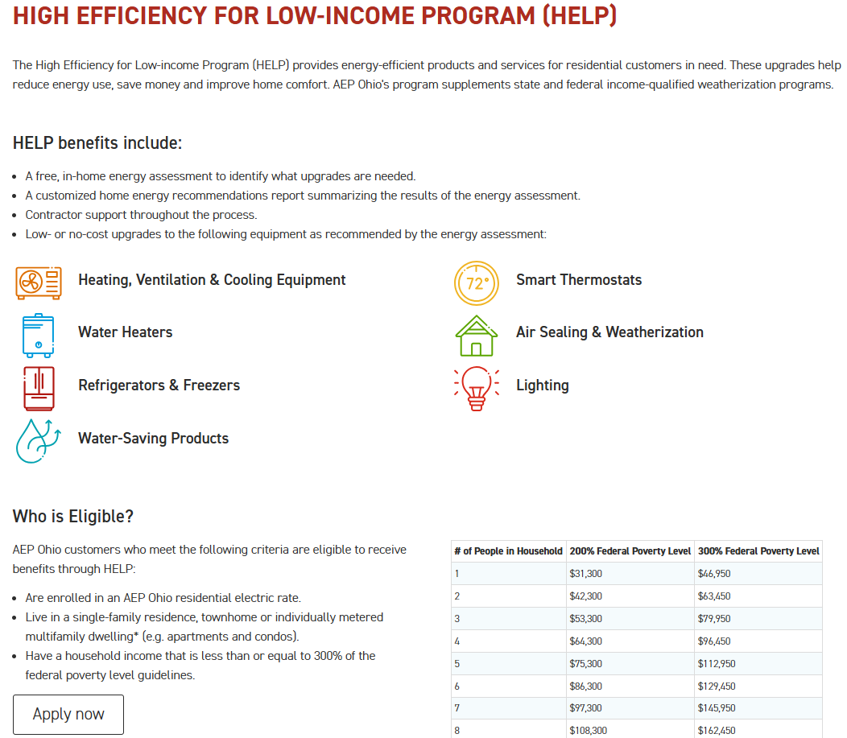

Program Application Review
Program applications can either be submitted online or via mail.
Online applications can be accessed through the AEP Ohio website (HELP Program) or directly through eSuite (Energy Suite - Program Information)
If via mail, completed applications should be mailed to the following address:
  AEP Ohio HELP Application Processing
  2223 S. Highland Drive, #E8-333
  Salt Lake City, UT 84106

Slide 32
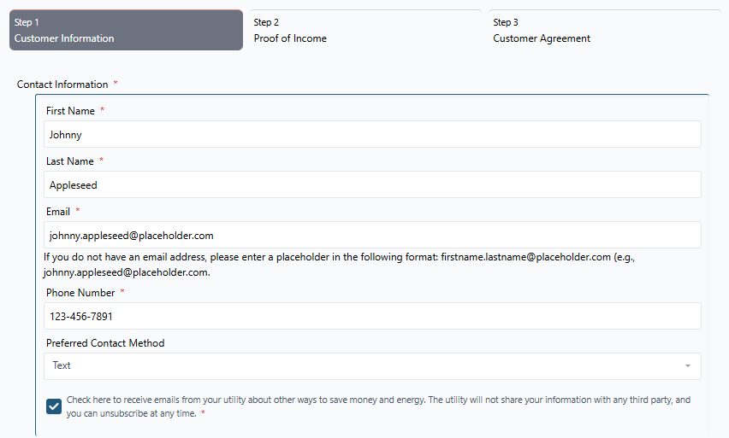
Program Application Review
For HHEAs submitting applications on behalf of a customer, please follow these steps:
1) Enter Customer Information
*If the customer has an email address, please include it. If the customer does not have an email address, please follow the help text and enter a placeholder email in the following format: firstname.lastname@placeholder.com

Slide 33
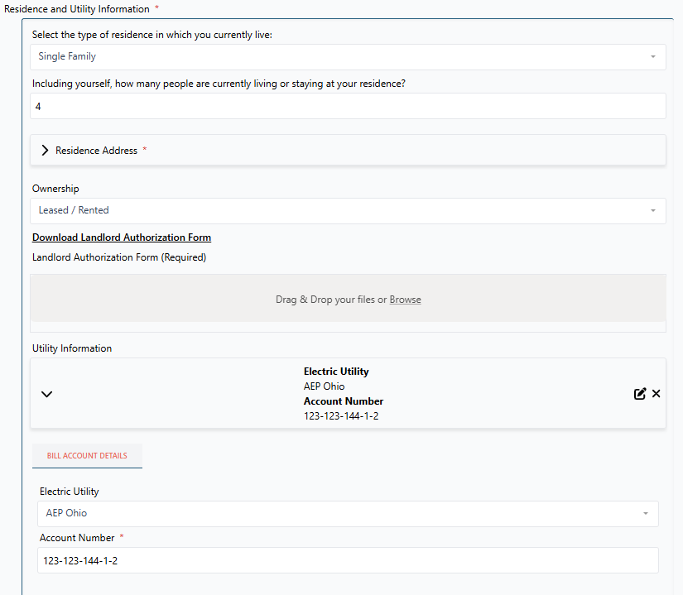
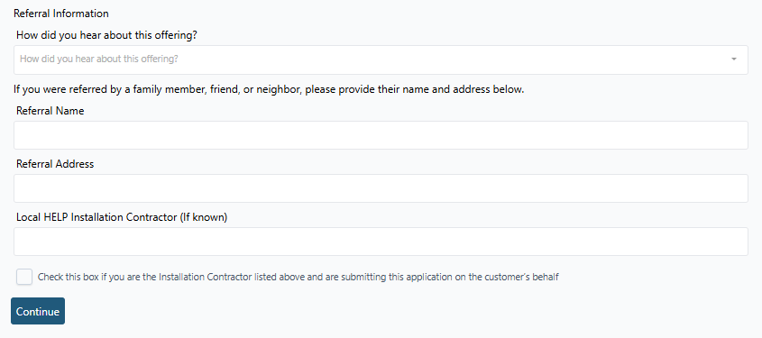
Program Application Review
2) Enter Residence and Utility Information
  When ownership is Leased/Rental, a Landlord Authorization Form is required
    Click on the link to download the form
    Obtain landlord signature
    Upload completed document
3) Referral Information (optional)
  Eligible customers who have participated in the program can receive a $25 gift card for referring a neighbor.
  Customers will receive a survey once their assessment is complete and all eligible measures installed. This survey includes an option to refer a neighbor.
  If the referred neighbor applies and is approved to participate, the original customer will receive a $25 gift card.
  If a neighbor was referred, please record that information in this section
Please make sure this box is checked if you are completing an application on behalf a customer
Enter the account number in the format listed on the bill including hyphens

Slide 34
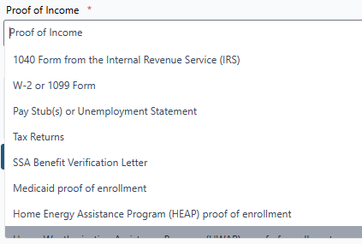
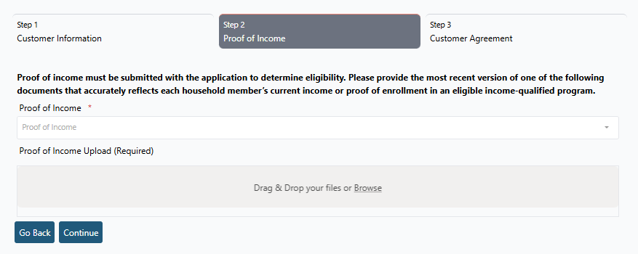
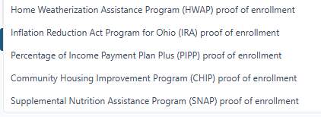
Program Application Review
4) Upload Proof of Income
  Acceptable forms are listed in the drop-down menu
  Uploaded forms should be dated within the current calendar year
  Proof of income should be submitted for each household member

Slide 35
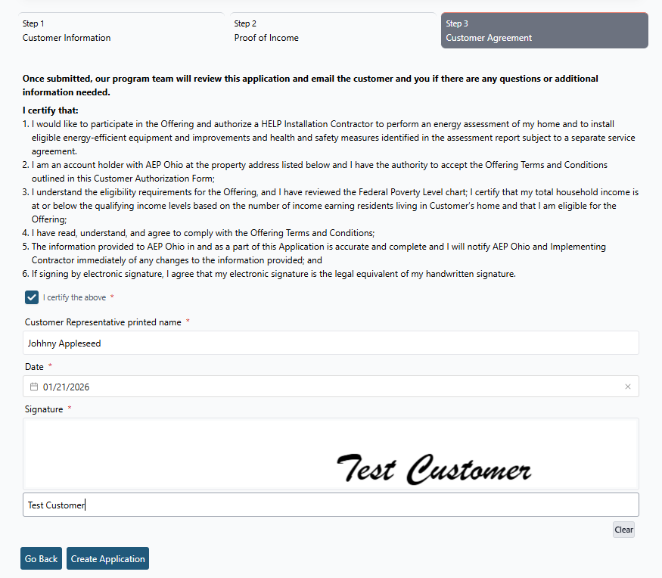
Program Application Review
5) Customer Agreement
  If submitting on behalf of a customer, please review this section with them to ensure they understand what they are certifying.
  Additionally, enter your name in the “Customer Representative printed name” field
  Use the calendar icon to enter the date
  Either have the customer sign in the signature box or type their name in the “Type Signature” field
6) Click “Create Application”

Slide 36
Assessment Scheduling
The AEP Ohio HELP program team will share newly approved customer applications with HHEAs on a weekly basis
Upon receipt of these leads, HHEAs are expected to make initial contact with customers within five (5) business days
HHEAs will schedule assessments directly with customers
Assessment schedules need to be shared with the program team on a regular, consistent cadence to support accurate tracking of of project flow and spend

Slide 37
ASSESSMENT REVIEW & BEST PRACTICES

Slide 38
Energy Assessment Best Practices
1) Prepare for the assessment
Verify all data, including the customer’s eligibility type (CAP vs. SLP), address and appointment time.
  It’s recommended to call the customer the day before to confirm the appointment and remind them that access to all areas of the home will be needed.
Ensure all equipment is in proper working order.
  Devices should be fully charged, and Direct Install equipment fully stocked
Have a copy of the assessment report, either electronically or on paper.
Arrive on time, or slightly early.
Dress professionally & appropriately.

Slide 39
Energy Assessment Best Practices
2) Greet the homeowner
Greet the customer and introduce yourself.
Confirm that they were expecting your visit. Make an effort to help them feel comfortable.
Explain what you will be looking for during the assessment: data plates on refrigerators, freezers, hot water heaters, furnaces, and outdoor HVAC units, as well as the age and efficiency of the HVAC system and insulation levels. Providing a brief overview of the program and inviting questions helps the process run smoothly.
Take this opportunity to ask questions that help the customer feel at ease in their home and understand what prompted them to apply to the AEP Ohio HELP program.
It’s recommended to ask if they have previously received weatherization services, as this information is helpful for guiding your assessment.

Slide 40
Energy Assessment Best Practices
3) Conduct the Energy Assessment
We recommend starting the assessment in the furnace room, as the hot water heater and furnace fuel type determine the measures for which the client may be eligible.
As you move through the home, observe and document items such as lighting, thermostat, air cleaner, and other opportunities to reduce energy usage. Engage the customer in the assessment process to help them understand the evaluation of their home.
Take photos of all program-related items.
  We recommend capturing both overview and data plate photos of the furnace and hot water heater regardless of fuel type, for future reference if needed.

Slide 41
Energy Assessment Best Practices
Explain to the customer that replacement appliances will be similar in size and finish where available, but the program does not guarantee brands or features, except for icemakers and water dispensers.
Take measurements and photos of the access path and doorway size if recommending large equipment, especially appliances in older homes.
  We require a 3’ wide path, clear of obstructions, for the installation of appliances
  Inform the customer that they are responsible for clearing the access path prior to installation
Complete direct install(s), ensuring you take before and after photos for assessment data entry in eSuite
Be sure to clean up, replace any items that were moved, and remove old equipment that were replaced during the direct install, such as bulbs, aerators, showerheads, air cleaners, etc.

Slide 42
Energy Assessment Best Practices
4) Next Steps
Explain to the customer what to expect from the assessment. Review the Assessment Report, including recommended measures and the anticipated timeframe for completion.
If certain items cannot be addressed through the AEP Ohio HELP program due to fuel type, inform the client about other services your organization offers or refer them to the local CAA serving their county or territory.
Ask the customer if they have any questions before you leave.
  HHEAs can provide customers the program email address, aepohiohelp@resource-innovations.com, and the call center number, 888-642-9363, for any follow-up questions.
Thank the client for applying to the AEP Ohio HELP Program.

Slide 43
Energy Assessment Best Practices
Retrofit Measure Install Turnaround Times
Outlined below are the current estimated installation turnaround times for retrofit measures
These estimates can be used as a reference when setting customer expectations and discussing next steps
Re-assigned retrofit projects are prioritized in the order they are received
  If a case is urgent (for example, a customer without heat), please email the program team with details of the situation so we can expedite the process
HVAC & HPWH
Appliances
Weatherization Measures
1-3 months
1-3 months
3-4 months

Slide 44
BREAK (10 min)

Slide 45
ESUITE PROCESS FLOW REVIEW

Slide 46
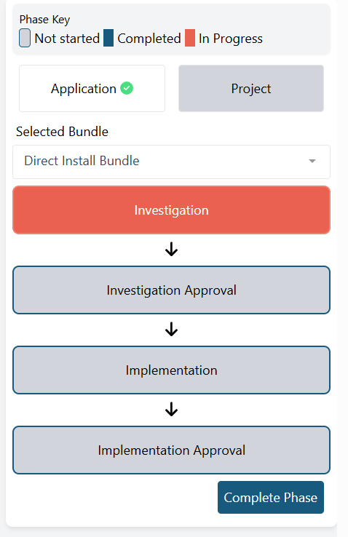
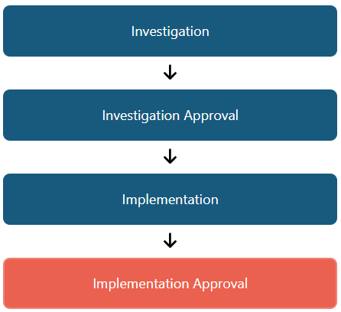
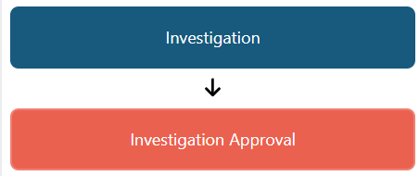
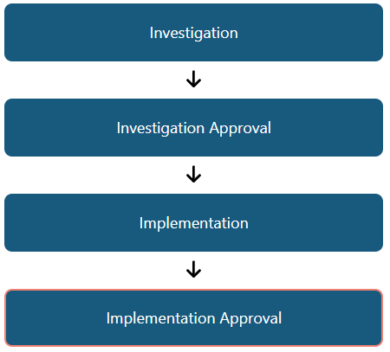
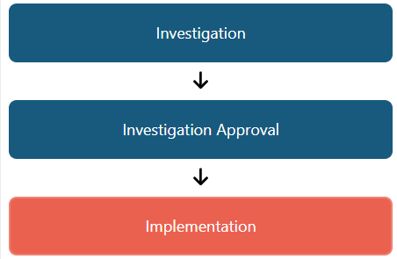
Project Workflow & Phase Definitions
Investigation Phase:
Investigation Phase:
A project in the Investigation phase indicates that the application has been approved and the project is ready for scheduling the home energy assessment. Once the energy assessment is complete, all required data should be entered in this phase. Once all data has been entered, click “Complete Phase” to move the project to Investigation Approval. This notifies the program team that the assessment is ready for review.
Investigation Approval Phase:
Investigation Approval Phase:
The Investigation Approval phase is only accessible to the program review team. For Direct Install bundles, if no updates are needed, it will be advanced through to completion and submitted for payment. For retrofit measures identified in the investigation phase, the program team will review and confirm eligibility. If the measure is deemed as eligible; the program team will advance the phase to Implementation.
Implementation Phase:
The Implementation phase applies only to Retrofit bundles. For retrofit installations, this phase is used to upload all required post-installation data. Once data entry is complete, click “Complete Phase” to move the project to Implementation Approval, notifying the program team that the retrofit measures have been installed and are ready for review.
Implementation Phase:
Implementation Approval Phase:
The Implementation phase is only accessible to the program review team. During this phase, all post-installation data for completed retrofit projects is reviewed, and if no updates are required, the project will be advanced to completion and submitted for payment.
Implementation Approval Phase:
Project Completion:
All phases are complete, indicated by the blue boxes for each phase. This signifies that the program team has reviewed all data, no further edits were required, and the project has been submitted for payment.

Slide 47
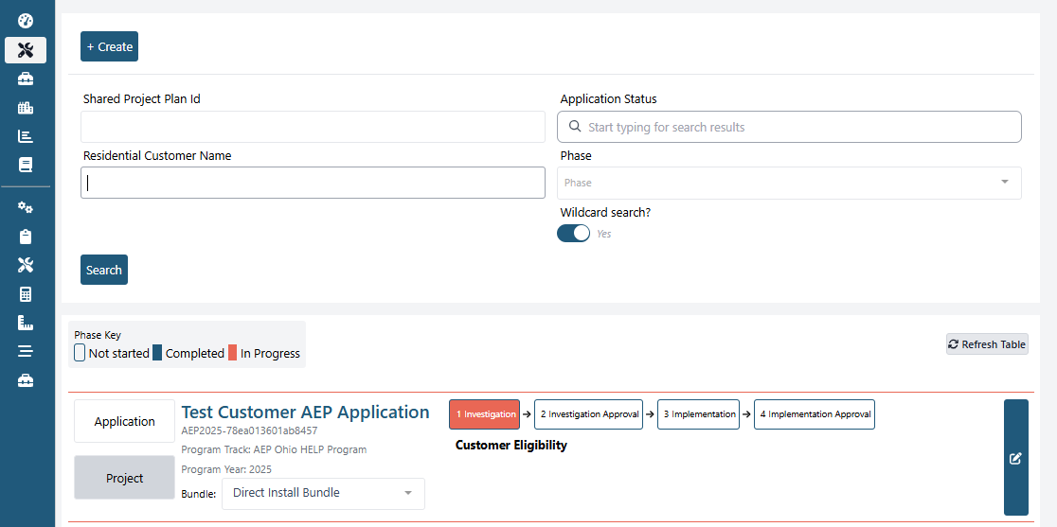
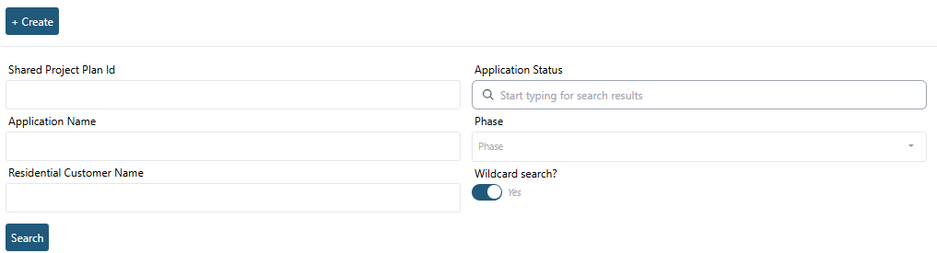


eSuite Process Flow Review
1) Hover over the tool icon & click on “Applications & Projects”
  This will take you to the full listing of all customer projects assigned to your company
2) Projects can be searched by Project ID, Application Name, Customer Name, Application Status, or Phase
Searching by Phase can be helpful when looking for newly approved applications. Newly approved, eligible applications can be found in the Investigation phase.
To open a project, you can either click the “Project” rectangle or click the phase rectangle
You can use the bundle dropdown to select different bundles and view their current phase.

Slide 48
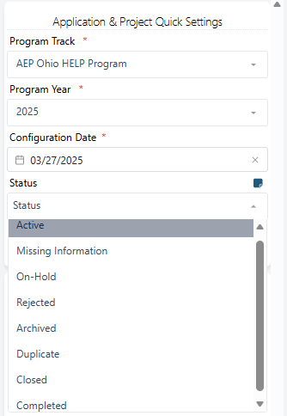
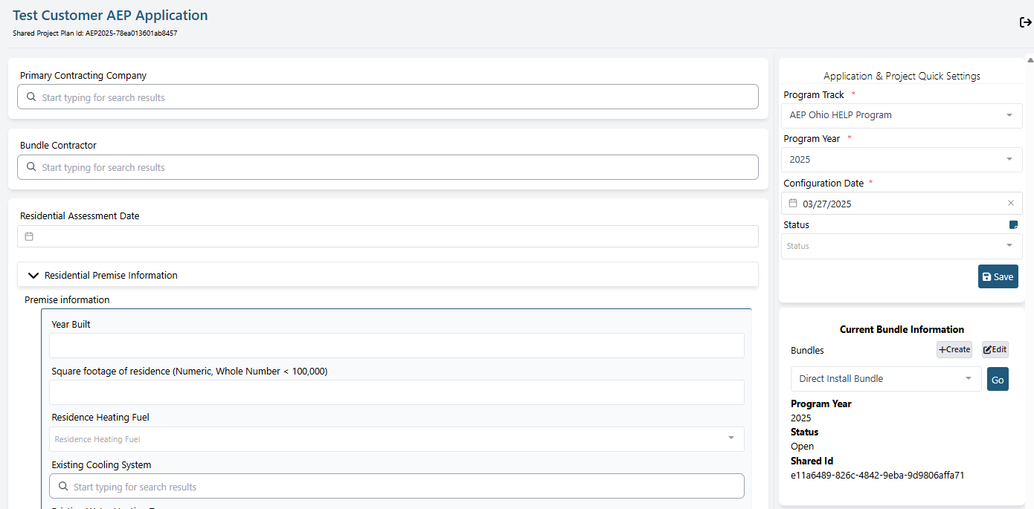
eSuite Process Flow Review
To view or change the status of an application, use the “Status” dropdown in the Application & Project Quick Settings sidebar

Slide 49
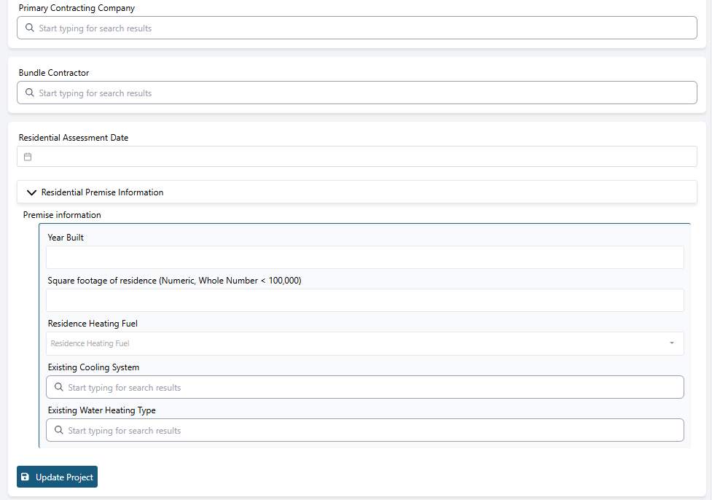
eSuite Process Flow Review
3) Please ensure all data is entered in the Residential Premise Information section including the Residential Assessment Date
Make sure to click “Update Project” so that all entered data saves

Slide 50
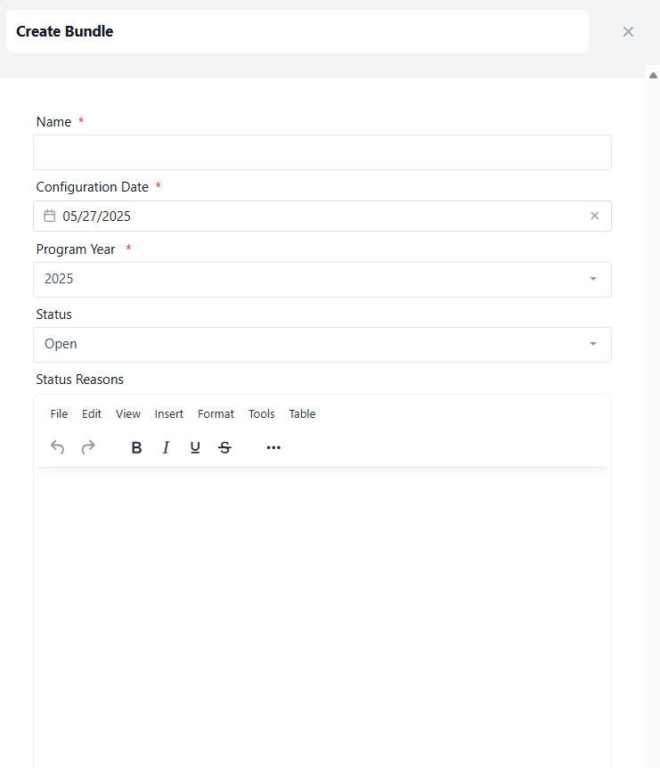
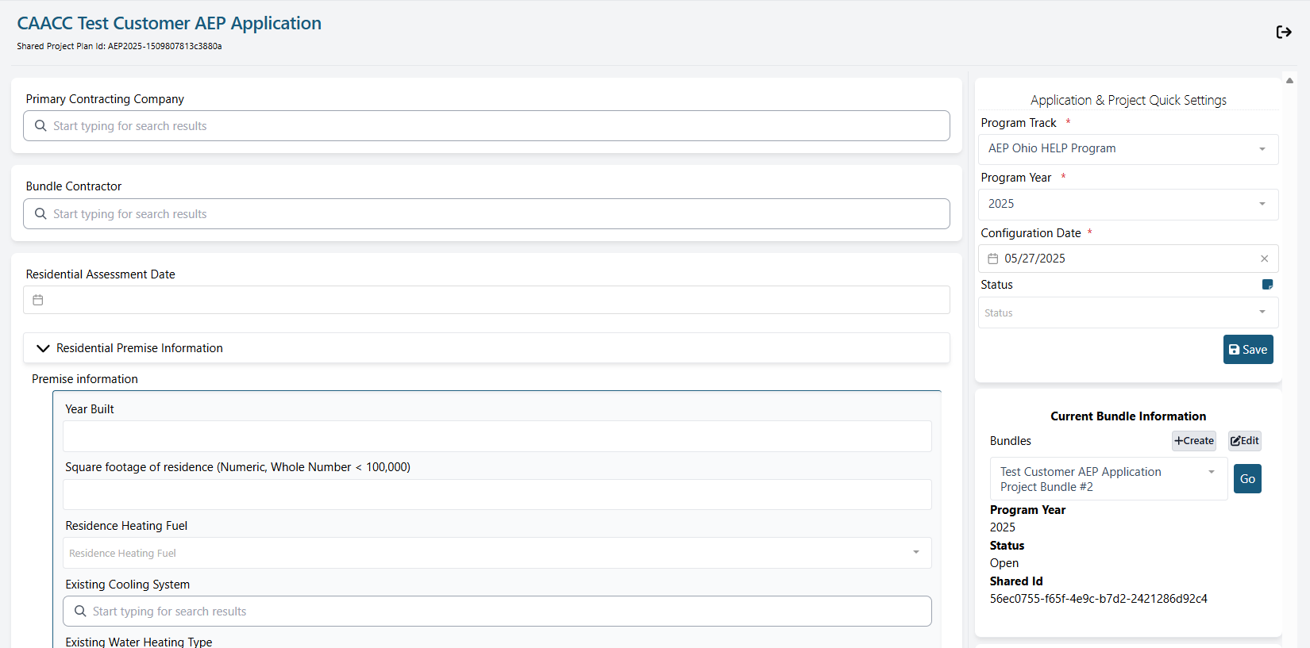
eSuite Process Flow Review
4) Create a Direct Install & Retrofit Bundle(s)
  Assessment fees should be added to the Direct Install (DI) bundle even if no DI measures are installed.
  Create separate retrofit bundles based on:
    Measures your company plans to install, and
    Measures you would like the program team to reassign to another contractor
  For retrofit measures you plan to install, assign your company as the “Bundle Contractor” within that bundle.
  Clearly name the bundles to reflect who will complete the work—for example: “CAA Retrofit Bundle” and “Other Contractor Retrofit Bundle”
  For retrofit measures you do not plan to install, leave the Bundle Contractor field blank and group measures into separate bundles by similar equipment type.
    For example: If a refrigerator and freezer are identified, include both in one bundle named “Appliance Retrofit Bundle – Other Contractor.”
    If a heat pump is also identified, include it in a separate bundle named “HVAC Retrofit Bundle – Other Contractor.”
Each project automatically generates a bundle with a default name. You can click “Edit” to rename the bundle, and then click “Create” to add additional bundles.
If you need to cancel or close a bundle, click “Edit” to update its status and provide a reason, if necessary.

Slide 51
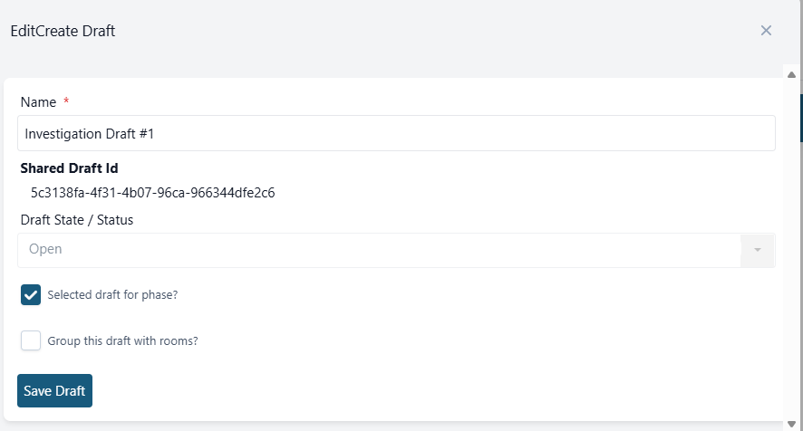
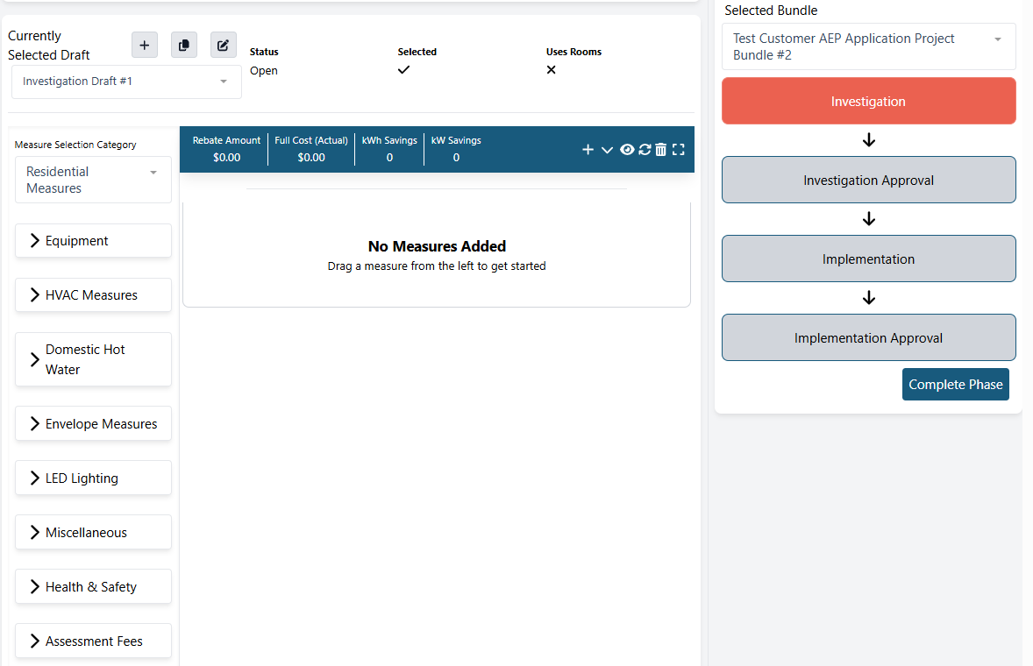
eSuite Process Flow Review
5) Drag and drop all installed measures into the center
If you don’t want to group measures by room, click the pencil and square icon and deselect “Group this draft with rooms”.
Please ensure “Selected draft for phase” is checked. There’s no need to create multiple drafts—you can use the one that’s automatically created.

Slide 52
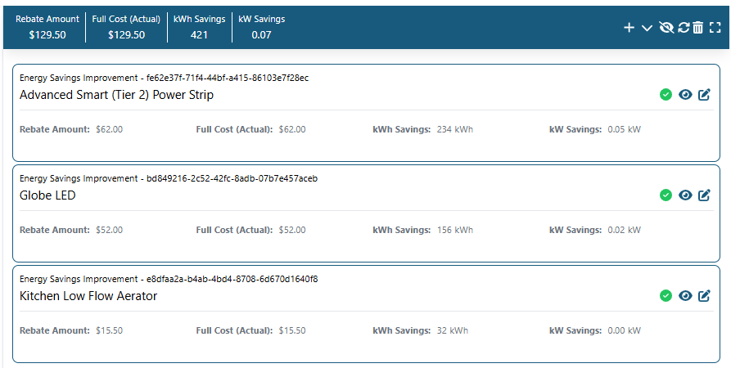
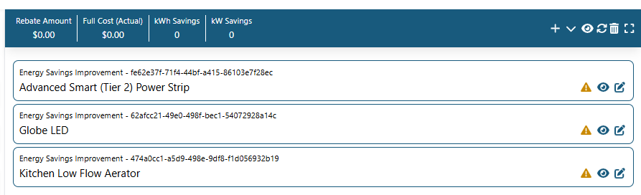
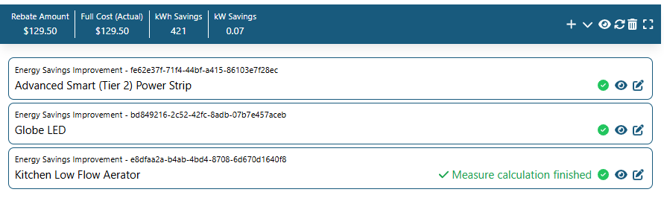
eSuite Process Flow Review
6) Once all measures have been added, click the pencil and square icon to add in equipment specs and pre and post install photos for each measure
To view the rebate and energy savings for each measure, click the eye icon in the blue summary bar at the top.
If changes were made or calculations are not appearing, click the refresh button
Once all required data is successfully entered for each measure, a green check mark will display, and the total bundle rebate and energy savings will populate in the blue summary bar on top

Slide 53
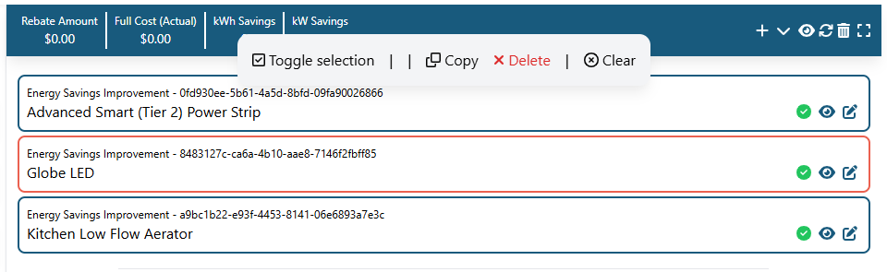
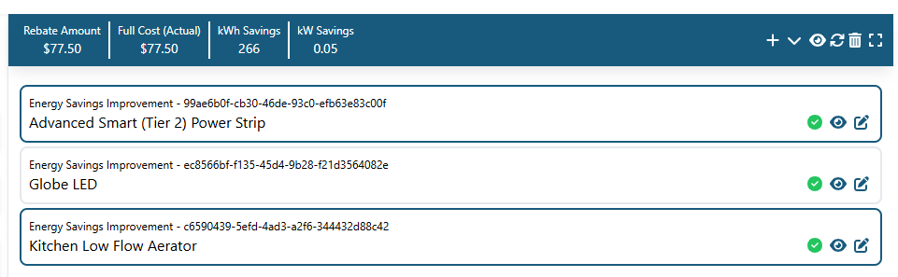
eSuite Process Flow Review
To delete a measure, click on it so it highlights in orange. A pop-up window will then appear with a “Delete” option.
Clicking “Toggle Selection” will change the measure from a blue highlighted box to a light gray box, indicating the measure has been toggled off. A toggled-off measure means it was not installed. Measures are typically toggled off because they were deemed ineligible. If a measure is toggled off by mistake, click it again and select “Toggle Selection” to turn it back on. When highlighted in blue, this indicates the measure has been or will be installed. This is important to note as it affects the total rebate and energy savings that is displayed in the top blue summary bar.

Slide 54
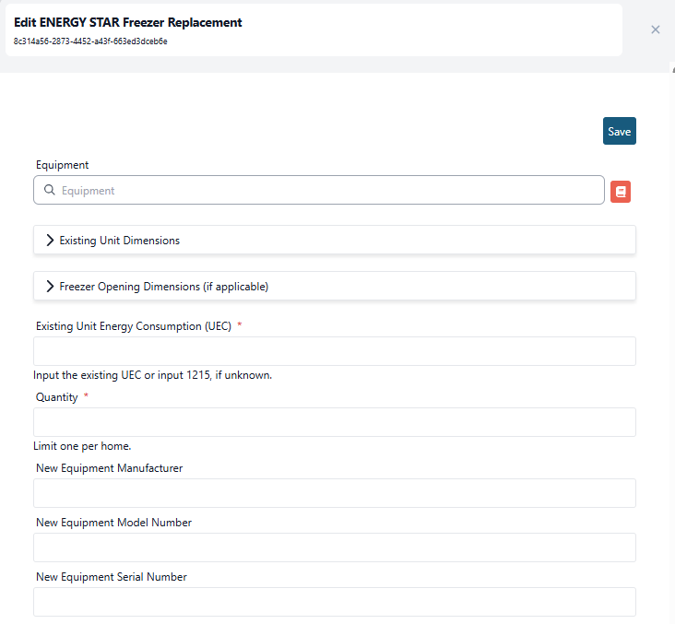
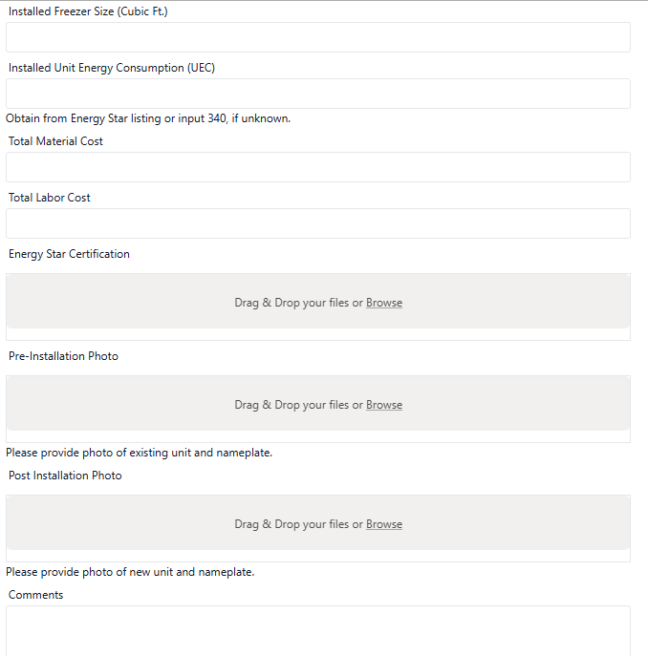
eSuite Process Flow Review
7) For retrofit bundles, upload the existing equipment data and photos within the specific measure.
  Replacement equipment details can be left blank unless you plan to handle the installation. If you will handle the install, please provide the replacement unit specs, Energy Star certificate (if applicable), and a quote for our review.
  Equipment lists and pricing can be submitted to the program team for review and pre-approval. If the equipment and cost have already been pre-approved and the identified retrofit measure is eligible for replacement, you can proceed with installation.
  However, if a unique situation arises requiring an exception for a model or price, you must check with the program team before proceeding.

Slide 55
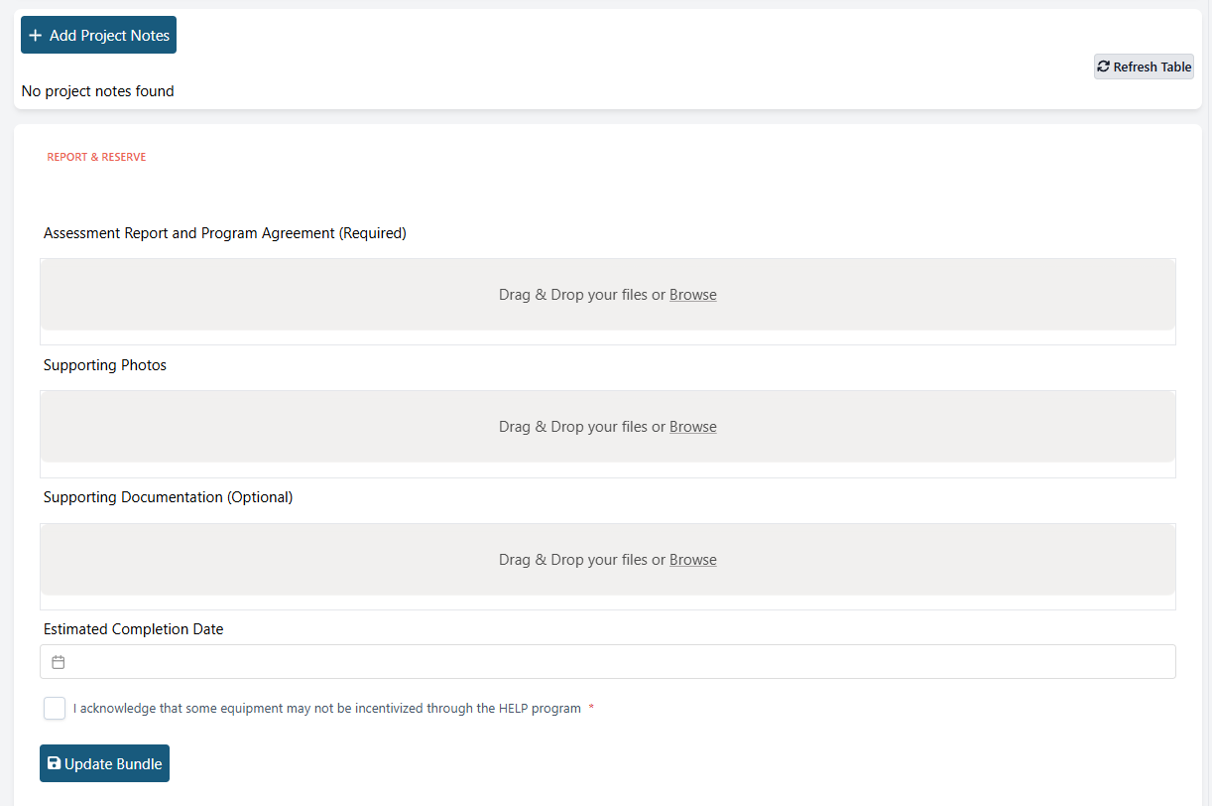
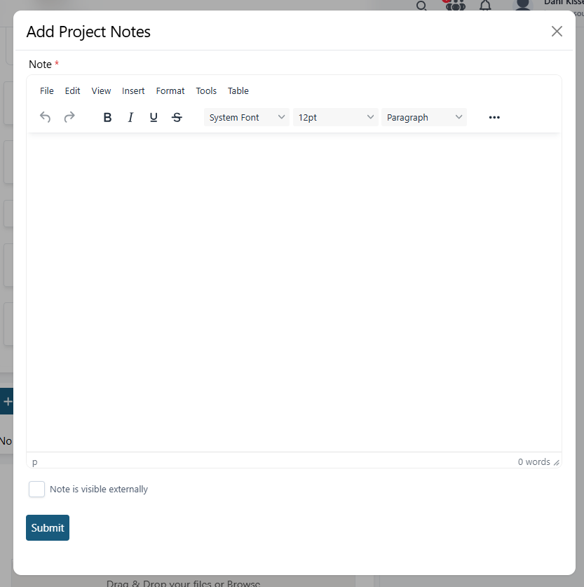
eSuite Process Flow Review
8) Upload signed Assessment Report & Program Agreement in the “Report & Reserve” section
  Pre- and post-installation photos for each measure should be uploaded within that measure. The Supporting Photos section is for any additional project photos not directly tied to a specific installed measure.
If there are any relevant notes from the customer’s assessment that would be informative to the program team, please add them to the “Project Notes” section
Enter an “Estimated Completion Date” for any retrofit measures you plan to install. This helps the program team monitor upcoming installations. For Direct Install bundles, you can enter the assessment date or leave it blank.
If you want the note to be visible to the program team, please ensure the “Note is visible externally” is checked
Click “Update Bundle” to ensure all changes are saved

Slide 56
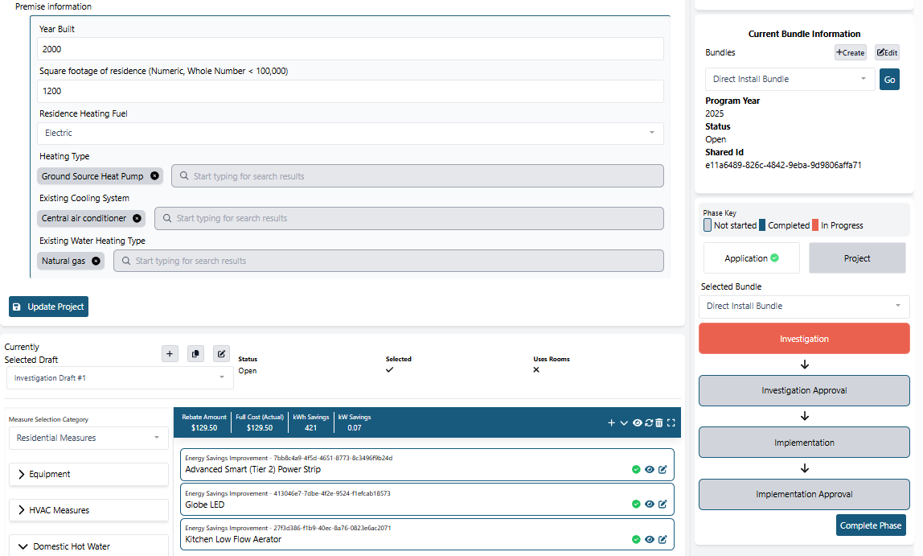
eSuite Process Flow Review
9) Once all assessment data has been entered, click “Complete Phase” for each bundle so it advances the phase to Investigation Approval
  As mentioned previously, this notifies the program team that the assessment is ready for review.

Slide 57
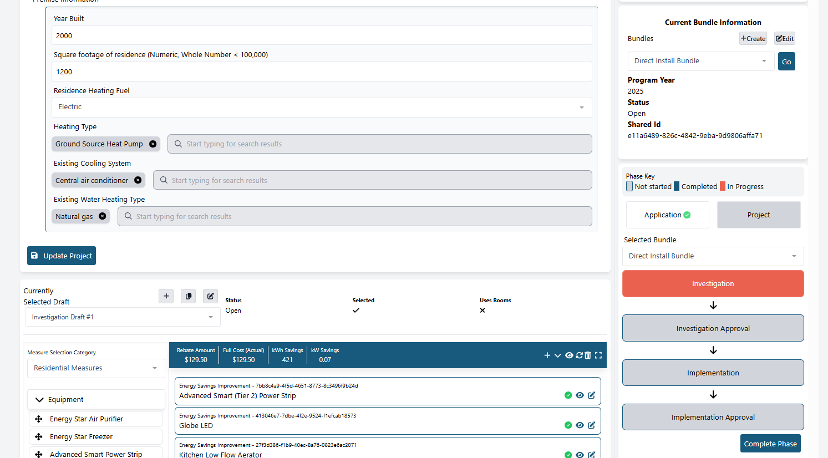
eSuite Process Flow Review
You can switch between bundles two ways:
  Using the “Current Bundle Information” section:
    Click the dropdown arrow, select the bundle, and then click “Go”.
    This method automatically takes you to the latest phase of the selected bundle.
    For example, if a bundle is in the “Implementation” phase, clicking “Go”, will automatically take you to that phase
    However, if the bundle is in an Approval phase, this method will trigger an access error as these phases are restricted to program team only.
  Using the “Selected Bundle” section:
    Click the dropdown arrow, select the bundle, and then click the phase you want to navigate to.
    This method lets you choose the specific phase rather than automatically taking you to the latest phase
    For example, if a bundle is in the “Investigation Approval” phase, you can use this method to go back to the “Investigation” phase without receiving an access error.

Slide 58
eSuite Process Flow Review
10) Once assessment data advances to the Investigation Approval phase, the program team will complete their review:
  Direct Install Bundles: if all required fields are complete and no additional information is needed, the bundle will be advanced through project completion and submitted for payment.
  Retrofit Bundles: if the existing equipment is eligible for replacement and the proposed unit meets program requirements, the program team will advance the bundle to the Implementation phase and confirm approval to proceed with installation.
11) After a retrofit measure is approved, you may schedule the installation directly with the customer.
12) After installation is complete, upload all required post-installation documentation (specs, photos, energy star certificates, final invoice, etc.) in the Implementation phase for the applicable measure.

Slide 59
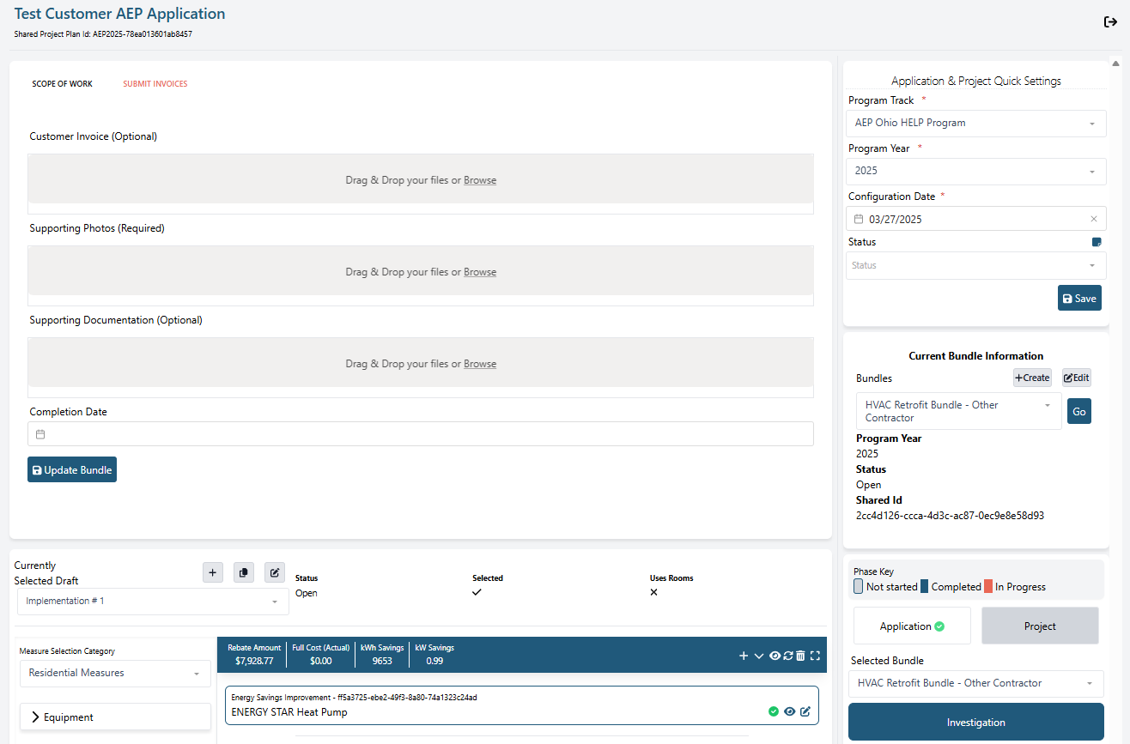
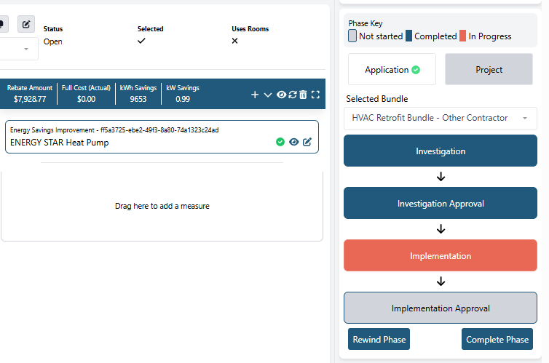
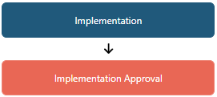
eSuite Process Flow Review
13) Click on the “Submit Invoices” section and enter the installation “Completion Date”
  Upload final invoices under “Supporting Documentation” or within the applicable measure
  For projects that involve customer cost sharing, you can upload their invoice to the “Customer Invoice” section
14) Click “Complete Phase” to advance the project to Implementation Approval for final program team review

Slide 60
eSuite Process Flow Review
15) If any required information is missing, the program team will contact you to request that the data be added in eSuite. Once all documentation is uploaded, the program team will complete the project and submit it for payment. A project is considered complete when all phases are displayed in blue.
PAYMENT TIMELINE
Batch payments are submitted every other Thursday.
Payments are processed under NET-15 terms, allowing up to 15 days for review from the initial submission date.
Once approved, funds are issued via ACH, which typically takes a few additional business days.
Overall, incentive payments are expected to be received within approximately 4–6 weeks from the date the project is approved in eSuite.

Slide 61
ESUITE MEASURE ENTRY REVIEW

Slide 62
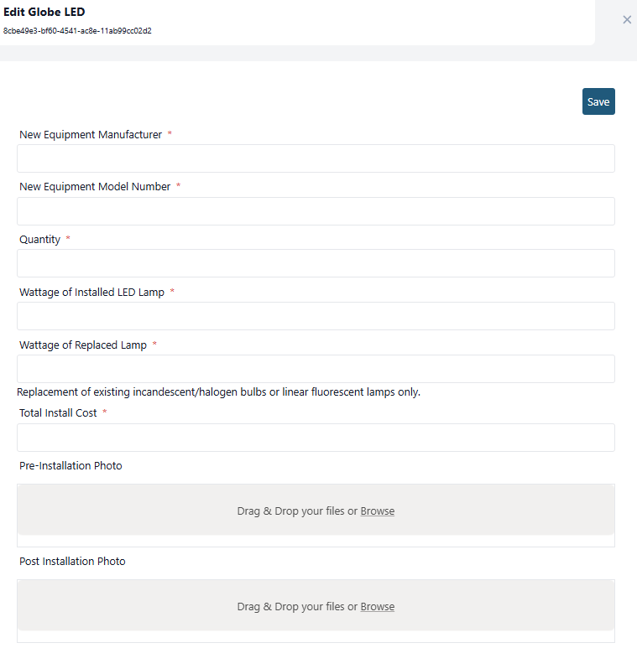
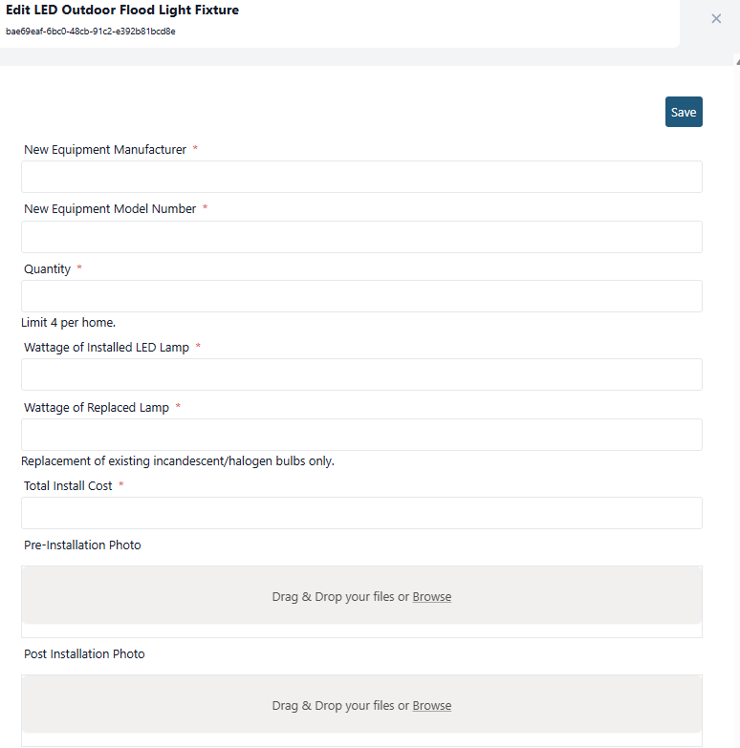
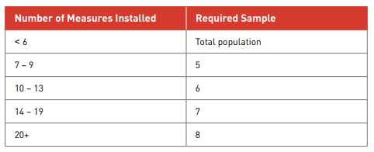
eSuite Measure Entry Review – Direct Install
Specialty LED Lighting & Outdoor Flood Lights:
A19 bulbs are not eligible measures under the program and may not be installed or replaced, regardless of bulb type or base.
The wattage of the Replaced Lamp for LED bulbs installed in empty sockets should be what the socket is rated.
If more than six (6) bulbs are installed, photo sampling is allowed as outlined in the table below:

Slide 63

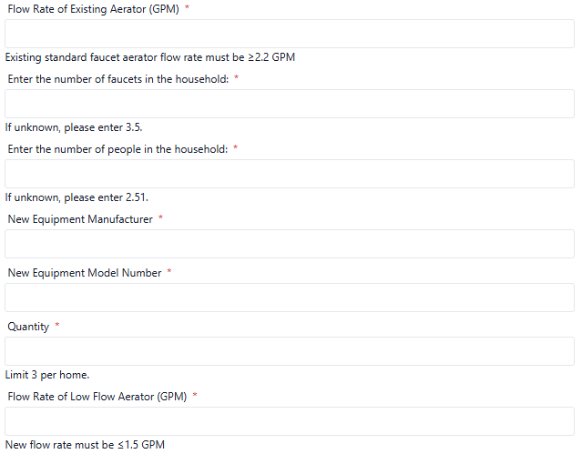
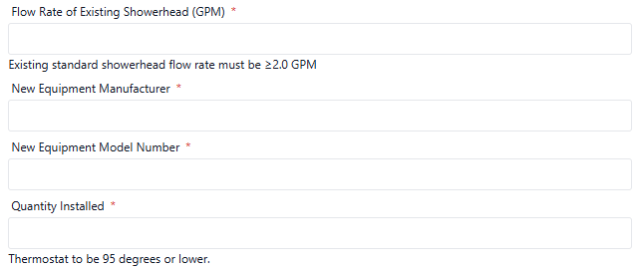
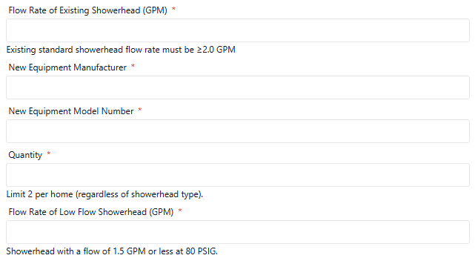
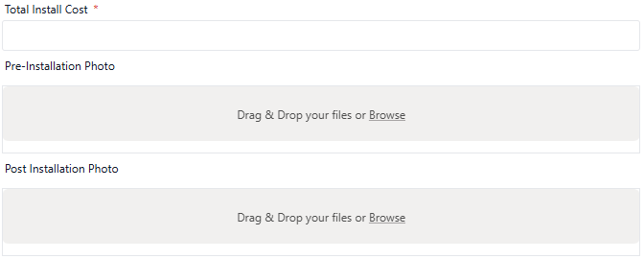
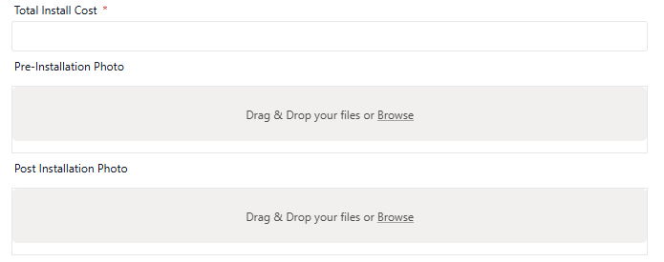
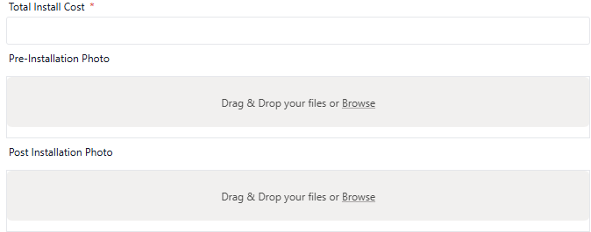
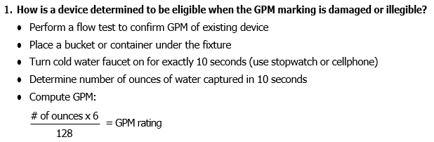
eSuite Measure Entry Review – Direct Install
Showerheads & Aerators:
Aerators: new required fields have been added to capture the existing flow rate, the number of people in the home, & number of faucets per home Showerheads: new required fields have been added to capture the existing flow rate
If the GPM of the existing unit is not clearly indicated, please perform a flow test to verify its actual GPM.

Slide 64
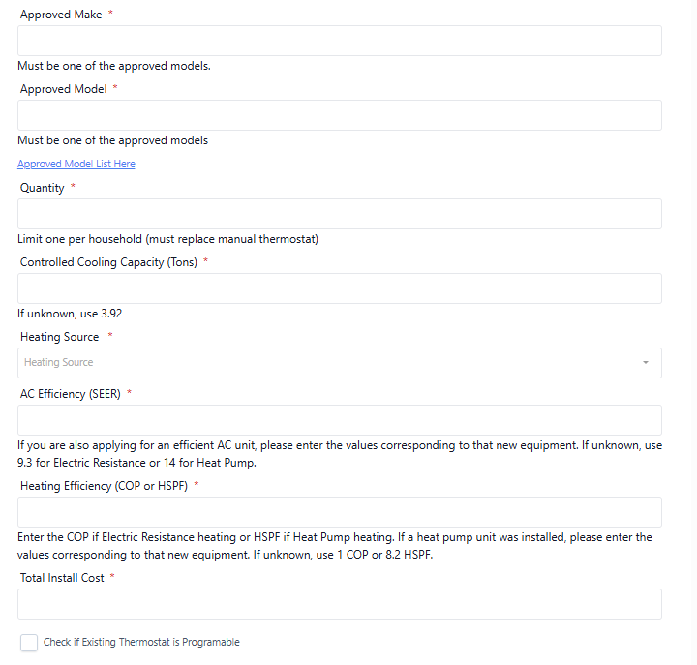
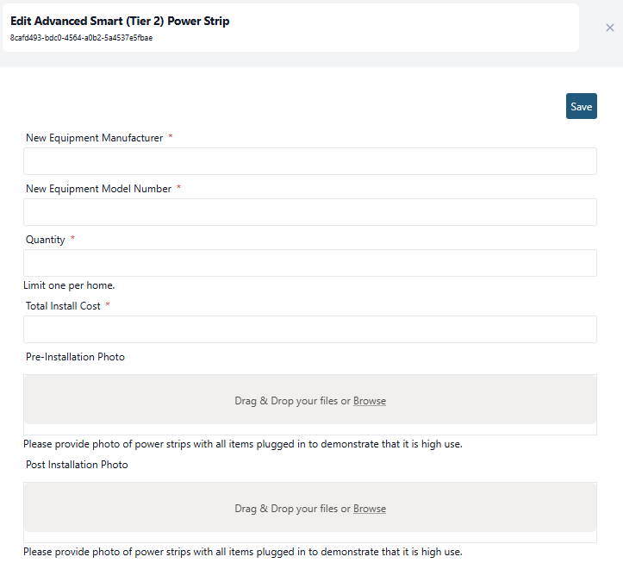
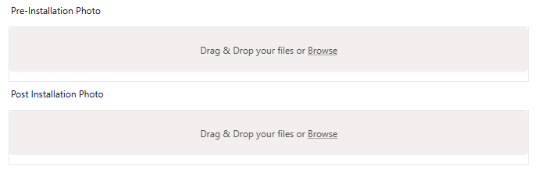
eSuite Measure Entry Review – Direct Install
Advanced Smart (Tier 2) Power Strip:
Existing power strips should only be replaced with a Tier 2 power strip in high-use areas, such as entertainment centers or home offices.
New Tier 2 power strips can be installed if one is needed in a high-use area as described above.
Tier 2 vs. Tier 1: Tier 2 power strips include an automatic shutoff sensor to save energy when devices are idle; Tier 1 strips do not.
WiFi Enabled Smart Thermostat:
New required fields have been added to capture the AC & Heating efficiency, with help text provided for guidance if the values are unknown

Slide 65
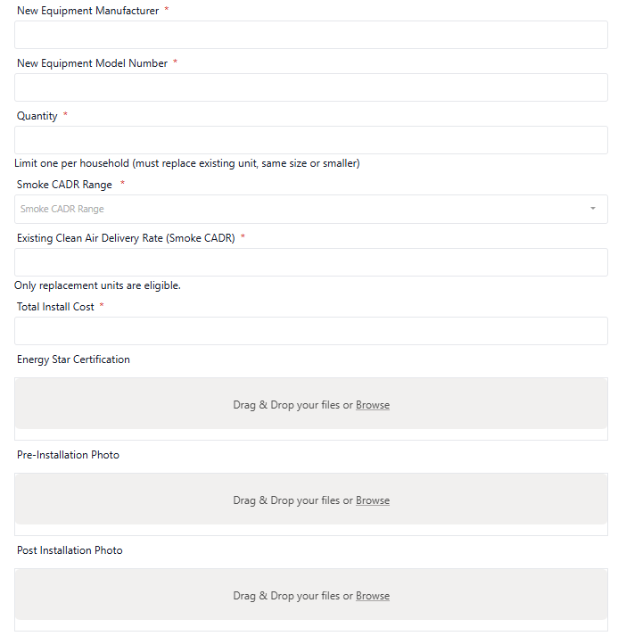

eSuite Measure Entry Review – Direct Install
Energy Star Air Purifier:
Energy Star Dehumidifier:

Slide 66



eSuite Measure Entry Review – Direct Install
Pipe Wrap:
Water Heater Tank Wrap:
Door Sweeps:

Slide 67

eSuite Measure Entry Review – Retrofit
Refrigerators & Freezers:
There are 5 different type of refrigerator units listed in eSuite:
  Energy Star Refrigerator 19-22 Bottom Freezer
  Energy Star Refrigerator 20-22 Top Freezer
  Energy Star Refrigerator 20-23 Side by Side or French Door
  Energy Star Refrigerator 24-26 Side by Side
  Energy Star Refrigerator 24-26 French Door
Please ensure the correct unit type is selected in the measure form, as the incentives vary by unit type.
  The final unit type entered must reflect the unit that was installed, even if it differs from the original unit type.

Slide 68


eSuite Measure Entry Review – Retrofit
Refrigerators & Freezers:
If you do not plan to complete the installation for this measure, documentation is required for the existing unit dimensions, opening space dimensions, and access path measurements.
This documentation is required to confirm there is a clear and accessible path for delivery and installation.
If any obstructions exist along the access path, it is the customer’s responsibility to ensure the path is cleared prior to installation.

Slide 69


eSuite Measure Entry Review – Retrofit
Refrigerators & Freezers:
The following documentation is required regardless of whether you plan to complete the installation for this measure:
  Existing door configuration
  Confirmation of whether an icemaker is present
  Existing unit UEC
  Pre-installation photos including:
    A photo of the unit showing surrounding clearance
    A clear, legible photo of the nameplate
    Photo(s) of the access path
  *Photos of only the unit or the nameplate are not acceptable; both are required.
  *If a nameplate is not present, please note this in the “Comments” section of the measure.
If you’re unsure of the existing unit UEC value, use the link listed in eSuite (Refrigerator and Freezer Energy Rating Online Search Tool | Department of Energy) to search by model number based on the manufactured date.

Slide 70


eSuite Measure Entry Review – Retrofit
Refrigerators & Freezers:
The following post installation documentation is required:
  New equipment manufacturer, model number, & serial number
  Installed unit UEC (*listed in Energy Star certificate)
  Installed unit size in cubic feet
  Total cost broken out into material & labor
  Energy Star Certificate
  Either a post-installation photo of the unit & nameplate OR a customer sign-off form that states the new unit model and serial number.
  Final invoice & install date

Slide 71

eSuite Measure Entry Review – Retrofit
Washers & Dryers:
Similar to refrigerators & freezers – if you do not plan to complete the installation for this measure, documentation is required for the existing unit dimensions, opening space dimensions, and access path measurements.
For basement installations:
  Measure the doorway going into the basement with the door open 90 degrees
  Measure the width of the steps in between the handrail and the wall
  Evaluate the condition of the steps and ensure its sturdy enough to support ~600lbs

Slide 72


eSuite Measure Entry Review – Retrofit
Washers & Dryers:
In addition to unit and access path measurements, we will also need the assessor to confirm the following:
  Washers:
    The washer outlet is rated for 120 volts and is present and operational
    The water supply valves are present, operational, and show no visible signs of corrosion
  Dryers:
    The dryer outlet is rated for 240 volts and is present and operational
    Proper venting is installed, exhausts to the exterior, and is within 6 feet of the dryer
This confirms that all required conditions are met prior to installation. Any issues identified are the customer’s responsibility to correct before installation can proceed.

Slide 73

eSuite Measure Entry Review – Retrofit
Washers & Dryers:
Lastly, the following documentation is required regardless of whether you plan to complete the installation for this measure:
  Water Heating Type
  Dryer Type (Electric or Gas)
  Integrated Water Factor of Baseline Equipment
  Pre-installation photos including:
    A photo of the unit showing surrounding clearance
    A clear, legible photo of the nameplate
    Photo(s) of the access path
    Photo(s) of current valves and outlets
  *Photos of only the unit or the nameplate are not acceptable; both are required.
  *If a nameplate is not present, please note this in the “Comments” section of the measure.
*for washer measure only

Slide 74


eSuite Measure Entry Review – Retrofit
Washers & Dryers:
The following post installation documentation is required:
  New equipment manufacturer, model number, & serial number
  Installed unit size in cubic feet
  Integrated Modified Energy Factor of Efficient Equipment
  Integrated Water Factor of Efficient Equipment
  Combined Energy Factor (CEF)
  Product Class
  Load (lbs)
  Total cost broken out into material & labor
  Energy Star Certificate
  Either a post-installation photo of the unit & nameplate OR a customer sign-off form that states the new unit model and serial number.
  Final invoice & install date
*for washer & all-in-one washer-dryer measures
*for HP dryer & all-in-one washer-dryer measures

Slide 75

eSuite Measure Entry Review – Retrofit
Heat Pump & Mini-Split Heat Pumps:
The following documentation is required regardless of whether you plan to complete the installation for this measure:
  Existing unit model number
  Cooling capacity of existing unit (tons)
  Existing heating source
    The existing heating source should reflect what the customer is currently using. For example, if a customer has a heat pump that’s nonfunctional and is relying on space heaters, electric resistance should be selected.
  Existing Part Load Cooling Efficiency (SEER)
  Pre-installation photos including:
    A photo of both the indoor & outdoor unit
    A clear, legible photo of both the indoor & outdoor unit nameplate
  *Photos of only the unit or the nameplate are not acceptable; both are required.
  *If a nameplate is not present, please note this in the “Comments” section of the measure.

Slide 76




eSuite Measure Entry Review – Retrofit
Heat Pump & Mini-Split Heat Pumps:
The following post installation documentation is required:
  New equipment manufacturer
  New equipment model number & serial number for both the indoor & outdoor units
  Cooling capacity (in tons for HP & in kBtu/h for mini-split systems)
  Heating capacity (always kBtu/h)
  Full Load Cooling Efficiency (EER2)
  Part Load Cooling Efficiency (SEER2)
  Heating Seasonal Performance Factor (HSPF2)
  Total cost broken out into material & labor
  AHRI or Energy Star Certificate
  Either a post-installation photo of the unit & nameplate OR a customer sign-off form that states the new unit model and serial number.
  Final invoice & install date

Slide 77



eSuite Measure Entry Review – Retrofit
Heat Pump & Mini-Split Heat Pumps:
AHRI or Energy Star certificates submitted should match the model numbers for the indoor & outdoor units that were installed.
  Replacement equipment specs listed in eSuite should match what’s listed on the certificate
Please note: the cooling and heating capacities shown on the AHRI certificate are in Btu/h. eSuite requires the heating capacity to be entered in kBtu/h and the cooling capacity in tons. Use the conversions below for reference:
$$Tons= \frac{BTU/h}{12,000}$$
$$kBtu/h= \frac{BTU/h}{1,000}$$
Cooling Capacity: 36,000 Btu/h = 3 tons
Heating Capacity: 37,600 Btu/h = 37.6 kBtu/h

Slide 78


eSuite Measure Entry Review – Retrofit
Heat Pump Water Heaters:
The following documentation is required regardless of whether you plan to complete the installation for this measure:
  Existing unit model number
  Water heater location
  Space heating type
    The space heating type should reflect what the customer is currently using to heat their home.
  Dehumidifier usage
  Existing Unit Uniform Energy Factor (UEF)
  Number of people in the household
  Pre-installation photos including:
    A photo of the unit showing surrounding clearance
    A clear, legible photo of the nameplate
  *Photos of only the unit or the nameplate are not acceptable; both are required.
  *If a nameplate is not present, please note this in the “Comments” section of the measure.

Slide 79



eSuite Measure Entry Review – Retrofit
Heat Pump Water Heaters:
The following post installation documentation is required:
  New equipment manufacturer & model number
  Storage capacity (gallons)
  Uniform Energy Factor (UEF) (*listed in Energy Star certificate)
  Total cost broken out into material & labor
  AHRI or Energy Star Certificate
  Either a post-installation photo of the unit & nameplate OR a customer sign-off form that states the new unit model and serial number.
  Final invoice & install date

Slide 80

eSuite Measure Entry Review – Retrofit
Insulation:
Insulation should be recommended if the following conditions are satisfied:
  The home meets eligibility requirements (electric space heating and central AC or heat pump)
  A visual inspection of the relevant areas (attic, basement, etc.) indicates minimal or no existing insulation
Required pre-installation documentation:
Existing heating source
Photos of existing space that needs insulation work
Required post-installation documentation:
Existing insulation R-value
New insulation R-value
Total insulated area (square feet)
Total cost broken out into material & labor
Post-installation photo(s) of installed insulation including image of insulation bag/label with legible R-value
Final invoice & install date

Slide 81


eSuite Measure Entry Review – Retrofit
Air Sealing:
Air sealing should be recommended if the home has electric space heating and electric cooling (central AC, room AC, or heat pump) and a visual inspection reveals gaps, cracks, or drafts around windows, doors, baseboards, vents, or other building envelope penetrations.
Required pre-installation documentation:
Existing heating source
Cooling efficiency (SEER)
Heating efficiency (COP or HSPF)
Photo(s) of existing space that need air sealing
Required post-installation documentation:
Infiltration before air sealing is performed (CFM)
Infiltration after air sealing is performed (CFM)
Total cost broken out into material & labor
Post-installation photo(s) of:
  Unit number or front of home
  Air sealing around pipe penetrations, construction components
  Weather stripping around windows and doors Attic access cover
  Knee wall door insulation and air sealing
  Pre and post CFM blower door readings from pressure gauge
  Complete ASHRAE Calculator such as Red Calc ASHRAE 62.2-2016
  Ventilation calculator and submit screenshot with submission.
Final invoice & install date

Slide 82


eSuite Measure Entry Review – Retrofit
Duct Sealing:
Duct sealing should be recommended if the home has electric space heating and central AC, and a visual inspection of the ductwork reveals gaps, cracks, disconnected sections, corroded or deteriorated material, or dust buildup around connections. Additional indicators include uneven airflow from vents or significant temperature differences measured with a thermal gun.
Required pre-installation documentation:
Existing heating source
Photo(s) of existing space that needs duct sealing
Required post-installation documentation:
Leakage before duct sealing (CFM25)
Leakage after duct sealing (CFM25)
OR
Whole House CFM (before)
Whole House CFM (after)
Envelope CFM (before)
Envelope CFM (after)
House to Duct Pressure in Pa (before)
House to Duct Pressure in Pa (after)
AND
Total cost broken out into material & labor
Post-installation photo(s) of:
  Duct and/or registers after sealing
  Pre and post duct sealing pressure readings
Final invoice & install date
*Duct Blaster method
*Blower Door method

Slide 83



eSuite Measure Entry Review – Retrofit
Ceiling Fan:
Required pre-installation documentation:
Days of use
Daily fan “On Hours”
Baseline fan wattage at low, medium, and high speed
Baseline lighting wattage
Pre-installation photo of existing ceiling fan & nameplate
Required post-installation documentation:
New equipment manufacturer and model number
Replacement fan wattage at low, medium, and high speed
Replacement fan type (with light kit or ceiling fan only)
Replacement fan lighting wattage
Total cost broken out into material & labor
Energy Star certificate
Post-installation photo of replacement fan & nameplate
Final invoice & install date
*Help text is included if values are unknown

Slide 84

eSuite Measure Entry Review – Retrofit
Health & Safety Measures:
This measure allows HHEAs flexibility in leveraging assigned Program funds to address safety issues when necessary to support the installation of an eligible measure or to help improve the effectiveness or efficiency of a measure installed under this program.
  For example, a request for a new electric panel for a heat pump upgrade would be an acceptable health & safety measure to submit for program team review
To submit a Health & Safety measure, please provide a detailed description of the request along with a quote and any relevant images.

Slide 85
ESUITE NEW FEATURES

Slide 86


Equipment Library
The purpose of the Equipment Library is to allow HHEAs to enter and save commonly installed equipment and specifications for use in the measure picker. This enables users to auto-populate required fields when entering measures that were installed during an assessment, eliminating the need for repeated manual entry.
1) To access the Equipment Library, hover over the toolbox icon in the blue sidebar and click on “Equipment Library”

Slide 87


Equipment Library
2) To create equipment, click the “Create Equipment” button
3) Select the appropriate measure from the dropdown menu
4) Enter an equipment name. We recommend including unique identifiers such as the manufacturer and model number to make it easier to locate the equipment later

Slide 88



Equipment Library
5) Input equipment specifications
6) Once complete, click “Create”
Newly added equipment will automatically be assigned a “Pending Approval” status. Once reviewed and approved by the program team, the status will reflect “Approved.”

Slide 89

Equipment Library
6) Now, once you click back into the Equipment Library, you will see your new equipment listed
To make edits or delete equipment, click the pencil & square icon

Slide 90


Equipment Library
7) When adding installed measures in phases, you can search for previously saved equipment by typing in the Equipment Search bar or by clicking the red book icon.
8) After the measure is selected, it will automatically populate the equipment specifications.
*Please note: all existing unit details must still be entered manually, as well as corresponding photos.
You can also see the status of your equipment here for reference
If any auto populated fields need to be overwritten (for example, due to a price change), click directly into the field and update the existing information.

Slide 91
eSuite Features In Progress
Upload multiple photos simultaneously
Measure copy feature that allows users to duplicate measures within the same bundle or copy to anther bundle
Weekly batch payments for quicker payment turnaround
eSuite generated Assessment Report, including customer payback calculations based on installed measures
Built-in scheduling tool
Program reporting & dashboard visualizations
Automated email triggers to keep customers and HHEA informed as project progresses
Enhanced search functionality within the Applications & Projects overview, including:
  Search by assessment date or time period
  Search by customer address

Slide 92
PROGRAM RESOURCES

Slide 93
Points of Contact
Christine Greene
Program Coordinator
Primary focus: day-to-day program operations
Tim Petrides
Outreach & CAA Management
Primary focus: training, communication, and CAA support
Assessment scheduling and coordination
Customer issue resolution
eSuite troubleshooting and user support
eSuite troubleshooting and user support
Quality assurance and compliance with program standards and specifications
Appliance retrofit project support
Weatherization retrofit project support
Application intake and processing
Outreach and marketing materials
Assessments & inspections
Onboarding and in-field training
David Richard
Contractor Management
Primary focus: contractor oversight & project support
Dani Kissel
Program Manager
Primary focus: program delivery & performance
Project exception request review
Incentive processing and payment
Resolution of issues impacting program delivery
Contractor onboarding
Process improvement
Program communications and updates
Program reporting
HVAC & HPWH retrofit project support
In-field project related escalations
Quality assurance and compliance with program standards and specifications

Slide 94

Resource Hub
The Resource Hub serves as a centralized location for all HELP program materials and reference documents used by HHEAs and Installation Contractors.
The Resource Hub can be accessed via the following link:
HELP Resource HUB | aepohhelp

Slide 95

Trade Ally Procurement Portal
The Procurement Portal is available as a resource for the purchase of Direct Install measures that meet Program requirements.
Standard delivery timeframe is 15 business days from the time of purchase.
Purchases can be returned within 30 days from date of delivery.
  Items should be returned in their original condition.
  Refund will be processed within 5-7 business days upon receival of returned item
  Products that have been installed or are not in original resale condition cannot be refunded
www.aep-ohio-contractor-portal.com

Slide 96
2026 EXPECTATIONS & NEXT STEPS

Slide 97
Expectations & Next Steps
2026 Expectations​:
Improve turnaround times across all phases — application, assessment, data entry, installations, etc.​
Reach out to eligible customer leads within 5 business days of receiving them.​
Enhance customer education during assessments, including clear explanations of eligibility and why certain measures may not qualify.​
  Most negative feedback this year stemmed from customers feeling unclear about what was installed or why certain measures were not eligible.​
Ensure Direct Install equipment is fully stocked for every assessment to prevent missed opportunities.​
Submit data entry within 30 days of the assessment date.​
Share assessment schedules and pipeline updates on a consistent cadence with Resource Innovations to ensure accurate monitoring of project flow and spend.​
Ensure accurate documentation is captured for both existing and newly installed equipment to allow the program team to verify eligibility and installation details.​
​

Slide 98
Expectations & Next Steps
2026 Program Documentation
Updated program documentation (including the Energy Assessment Report, Program Manual, etc.) will be uploaded to the Resource Hub and shared via email this week
Agencies will be notified once the materials are available and should begin using the updated documentation starting 2/2/26
Next Steps (enrolled agencies):
Complete year end meeting (if not scheduled/completed already) to review 2025 performance and set goals for 2026
Schedule in-field training for any new auditors
Next Steps (new agencies):
Complete the enrollment forms listed under the “HELP Home Energy Assessor Enrollment Forms” section on the Resource Hub: HELP Resource HUB | aepohhelp
  HELP Home Energy Assessor (HHEA) Service Agreement​
  HHEA Background Investigation Certification and Key Personnel List
Email completed forms to aepohiohelp@resource-innovations.com

Slide 99

QUESTIONS?
Questions?

Slide 100
THANK YOU FOR JOINING US TODAY!

Slide 101
APPENDIX

Slide 102
Customer Eligibility & 2026 FPL Guidelines

Slide 103
CUSTOMER ELIGIBILITY
Must be a current AEP Ohio residential electric customer participating in the Community Assistance Program (CAP) or Supplemental Low-Income Program (SLP):
Property Eligibility: Single-family homes, townhomes, manufactured homes, and separately metered multi-family dwellings (apartments and condos). Renters must obtain a signed Landlord Authorization Form.
 | CAP | SLP
Income Requirements: | Customers ≤ 200% of the Federal Poverty Level | Customers between 201% - 300% of the Federal Poverty Level
HELP Program Eligibility: | Free home energy assessment Free installation of program eligible *direct install measures (100% cost coverage) No cost or discounted installation of program eligible *contractor install measures please refer to slides 9-11 as coverage varies by measure
*Direct install = measures installed during home energy assessment
*Contractor Install = retrofit opportunities and other more complex installations

Slide 104
2026 Federal Poverty Level Chart
Household Family Size​ | 2026 Federal Poverty Level (Annual Income)​
 | 100%​ | 200%​ | 300%​
1​ | $15,960 | $31,920 | $47,880
2​ | $21,640 | $43,280 | $64,920
3​ | $27,320 | $54,640 | $81,960
4​ | $33,000 | $66,000 | $99,000
5​ | $38,680 | $77,360 | $116,040
6​ | $44,360 | $88,720 | $133,080
7​ | $50,040 | $100,080 | $150,120
8​ | $55,720 | $111,440 | $167,160
Each person over 8, add​ | $5,680 | $11,360 | $17,040

