Slide 1

HIGH EFFICIENCY FOR LOW-INCOME PROGRAM (HELP)
AEP Ohio HELP Program
2026 Contractor Meeting
March 26, 2026
Notes:
Tim to lead introduction

Slide 2
AGENDA
Welcome & Team Introductions
Program Overview & Project Workflow
Retrofit Measures – Appliances
Retrofit Measures – Heat Pumps, Mini-Split Systems, Heat Pump Water Heaters
Retrofit Measure – Weatherization (Insulation, Air Sealing, Duct Sealing)
Program Resources
Questions & Feedback

Slide 3
KEY PROGRAM CONTACTS
Deanna Gilliland
AEP Ohio – EE & Consumer Programs Manager
dmgilliland@aep.com
614-935-3120
Dylan Matthews
Resource Innovations – Solution Delivery Director
Dmatthews@resource-innovations.com
773-415-8239
Dani Kissel
Resource Innovations – Solution Delivery Lead
Dkissel@resource-innovations.com
513-207-8420
Tim Petrides
Resource Innovations – Market Engagement Lead
tpetrides@resource-innovations.com
614-929-8269
Christine Greene
Resource Innovations – Solution Delivery Coordinator
cgreene@resource-innovations.com
614-327-9464
David Richard
Resource Innovations – Solution Delivery Manager
drichard@resource-innovations.com
614-849-2483

Slide 4
Points of Contact
Christine Greene
Program Coordinator
Primary focus: day-to-day program operations
Tim Petrides
Outreach & CAA Management
Primary focus: training, communication, and CAA support
Assessment scheduling and coordination
Customer issue resolution
eSuite troubleshooting and user support
eSuite troubleshooting and user support
Quality assurance and compliance with program standards and specifications
Appliance retrofit project support
Weatherization retrofit project support
Application intake and processing
Outreach and marketing materials
Assessments & inspections
Onboarding and in-field training
David Richard
Contractor Management
Primary focus: contractor oversight & project support
Dani Kissel
Program Manager
Primary focus: program delivery & performance
Project exception request review
Incentive processing and payment
Resolution of issues impacting program delivery
Contractor onboarding
Process improvement
Program communications and updates
Program reporting
HVAC & HPWH retrofit project support
In-field project related escalations
Quality assurance and compliance with program standards and specifications

Slide 5
PROGRAM OVERVIEW
Notes:
Tim to cover this section

Slide 6
Program Goals & Updates
2026 Program Goals & Incentive Budget:
All program changes that will be reviewed took effect Monday February 2nd, 2026
  This includes all newly offered program measures
Assessments completed before this date will be grandfathered in under the previous program guidelines
  100% CAP & SLP retrofit project cost coverage for assessments completed prior to 02/02/2026
  Measure eligibility requirements
 | Savings (kWh) | Peak Demand Reduction (kW) | Incentive Budget
2026 HELP Total | 8,000,000 | 1,800 | $7,685,900

Slide 7
CUSTOMER ELIGIBILITY
Must be a current AEP Ohio residential electric customer participating in the Community Assistance Program (CAP) or Supplemental Low-Income Program (SLP):
Property Eligibility: Single-family homes, townhomes, manufactured homes, and separately metered multi-family dwellings (apartments and condos). Renters must obtain a signed Landlord Authorization Form.
 | CAP | SLP
Income Requirements: | Customers ≤ 200% of the Federal Poverty Level | Customers between 201% - 300% of the Federal Poverty Level
HELP Program Eligibility: | Free home energy assessment Free installation of program eligible *direct install measures (100% cost coverage) No cost or discounted installation of program eligible *contractor install measures *coverage varies by measure
*Direct install = measures installed during home energy assessment
*Contractor Install = retrofit opportunities and other more complex installations

Slide 8
PROGRAM QUALIFYING ENERGY CONSERVATION MEASURES
Eligible customers will receive the following services at no cost:
Eligible customers will receive the following services at no cost or a discounted rate:
Walkthrough Home Energy Assessment to identify both energy saving measures and health and safety opportunities
Direct installation of low-cost energy saving devices during the assessment:
  Specialty LED light bulbs
  Tier 2 smart power strips
  Faucet aerators
  Showerheads
  Pipe wrap
  Air purifier / cleaner replacement
  Dehumidifier replacement
  Water heater tank wrap
  Door sweeps
Follow-up installation of home energy efficiency measures:
  Refrigerator Replacement (top freezer, bottom freezer, side by side, & french door units)
  Freezer Replacement
  Air Source Heat Pump
  Mini-Split System
  Heat Pump Water Heater
  Air sealing
  Duct sealing
  Insulation (attic, floor, wall, basement / sidewall, & rim joist)
  Clothes Washer Replacement
  Heat Pump Clothes Dryer Replacement
  All-in-One Clothes Washer-Dryer Replacement
  Ceiling Fan Replacement
Health and safety cost support
RED = 100% Coverage for both CAP and SLP Customers
BOLD = 100% Coverage for CAP Customers; 65% Coverage for SLP Customers
YELLOW = 90% Coverage for CAP Customers; 65% Coverage for SLP Customers

Slide 9
MEASURE REQUIREMENTS
APPLIANCES
Notes:
Dani to cover this section

Slide 10
Project Workflow - Appliances
Customer Submits Application
Application Review & Approval
Home Energy Assessment
Program Issues Payment
Identifies Eligible Retrofit Measures
Review & Pre-Approval of Appliance Measures
Program Review & Approval
Installs DI Measures
Assigns Project to Appliance Dealer
Schedules Delivery & Installation with Customer
Submits Completed Project Data
Resource Innovations
HELP Home Energy Assessor
Appliance Dealer

Slide 11
APPLIANCE - RETROFIT MEASURE INCENTIVES
Retrofit Measure Name | Unit | Measure Cost | Labor Cost | Total Incentive | CAP Incentive per Unit (90% of Cost) | SLP Incentive per Unit (65% of Cost)
ENERGY STAR Refrigerator Replacement 20-22 Top Freezer (includes icemaker if required) | Each | $890.00 | $225.00 | $1,115.00 | $1,003.50 | $724.75
ENERGY STAR Refrigerator Replacement 19-22 Bottom Freezer (includes icemaker if required) | Each | $1,150.00 | $225.00 | $1,375.00 | $1,237.50 | $893.75
ENERGY STAR Refrigerator Replacement 20-23 Side by Side or French Door (always includes icemaker) | Each | $1,300.00 | $225.00 | $1,525.00 | $1,372.50 | $991.25
ENERGY STAR Refrigerator Replacement 24-26 Side by Side (always includes icemaker) | Each | $1,325.00 | $225.00 | $1,550.00 | $1,395.00 | $1,007.50
ENERGY STAR Refrigerator Replacement 24-26 French Door (always includes icemaker) | Each | $1,500.00 | $225.00 | $1,725.00 | $1,552.50 | $1,121.25
ENERGY STAR Heat Pump Clothes Dryer | Each | $1,500.00 | $200.00 | $1,700.00 | $1,530.00 | $1,105.00
*Previously offered 27-28 cu. ft. French Door refrigerator replacements will no longer be included as an eligible measure due to cost effectiveness. Customers with this size and style unit may be eligible for replacement if they are willing to downsize to a 24–26 cu. ft. French door refrigerator.
*For measures not fully covered by the program, customers are responsible to pay the remaining costs. The customer’s cost share is to be coordinated directly between the customer and the contractor. The program will issue incentives in accordance with program guidelines, and contractors are responsible for collecting any outstanding balance from the customer.
  For example, if the total cost of a heat pump clothes dryer for a CAP customer is $1,700, the program would cover 90% ($1,530), leaving the customer responsible for the remaining $170.

Slide 12
APPLIANCE - RETROFIT MEASURE INCENTIVES
Retrofit Measure Name | Unit | Measure Cost | Labor Cost | CAP Incentive per Unit (100% of Cost) | SLP Incentive per Unit (65% of Cost)
ENERGY STAR Freezer Replacement | Each | $675.00 | $225.00 | $900.00 | $585.00
ENERGY STAR Ceiling Fan | Each | $225.00 | $125.00 | $350.00 | $227.50
ENERGY STAR All-in-One Clothes Washer-Dryer | Each | $2,300.00 | $200.00 | $2,500.00 | $1,625.00
ENERGY STAR Clothes Washer | Each | $1,000.00 | $200.00 | $1,200.00 | $780.00

Slide 13
Appliance - Retrofit Measure Requirements
 | Energy Star® Refrigerator
Residence Requirements | Electric or Non-Electric Water Heating | Electric or Non-Electric Space Heating
Measure Eligibility | Existing primary refrigerator must be operational or in need of minor repairs and manufactured 10 years or more prior to the current calendar year. Refrigerator must be owned by the property owner at the time of replacement. Renters are eligible to replace unit with landlord written approval. Water line repair, replacement, or modification is not covered by the program. Any required water line work must be addressed by the customer prior to installation. Approval may be requested on a case-by-case basis for non-operational units or those requiring major repairs, including units less than 10 years old
Measure Requirements | Replacement unit will be Energy Star certified and equivalent to the size of the unit currently installed (in ft³), including features such as through-door ice and water, if applicable. Existing equipment will be disabled and removed from the property.
Limits | 1 per household
Required Post Install Documentation | Final Invoice & install date ENERGY STAR Certificate Installed refrigerator type Installed refrigerator model number Installed refrigerator serial number Installed refrigerator manufacturer Installed refrigerator size (cubic feet) Installed Unit Energy Consumption (UEC) Photo of new refrigerator and nameplate or customer sign-off form that states the new unit model and serial number
Estimated SLP Customer Cost | The estimated CAP customer cost, after applying the measure rebate, ranges from $100 to $200 (dependent on refrigerator type). The estimated SLP customer cost, after applying the measure rebate, ranges from $300 to $800 (dependent on refrigerator type).

Slide 14
Appliance - Retrofit Measure Requirements
 | Energy Star® Freezer
Residence Requirements | Electric or Non-Electric Water Heating | Electric or Non-Electric Space Heating
Measure Eligibility | Existing primary freezer must be operational or in need of minor repairs and manufactured 10 years or more prior to the current calendar year. Freezer must be owned by the property owner at the time of replacement. Renters are eligible to replace unit with landlord written approval. Water line repair, replacement, or modification is not covered by the program. Any required water line work must be addressed by the customer prior to installation. Approval may be requested on a case-by-case basis for non-operational units or those requiring major repairs, including units less than 10 years old
Measure Requirements | Replacement unit will be Energy Star certified and equivalent in size to the unit currently installed (in ft³). Existing equipment will be disabled and removed from the property.
Limits | 1 per household
Required Post Install Documentation | Final invoice & install date ENERGY STAR Certificate Installed freezer type Installed freezer model number Installed freezer serial number Installed freezer manufacturer Installed freezer size (cubic feet) Installed Unit Energy Consumption (UEC) Photo of new freezer and nameplate or customer sign-off form that states the new unit model and serial number
Estimated SLP Customer Cost | The estimated SLP customer cost, after applying the measure rebate, ranges from $300 to $400 (dependent on freezer type).

Slide 15
Appliance - Retrofit Measure Requirements
​ | Energy Star® Clothes Washer​
Residence Requirements​ | Electric Water Heating​ | Electric or Non-Electric Space Heating​
Measure Eligibility​ | Existing primary washer must be operational or in need of minor repairs and manufactured 14 years or more prior to the current calendar year. ​ Washer must be owned by the property owner at the time of replacement. Renters are eligible to replace unit with landlord written approval, and the new appliance must remain in the unit after installation. ​ Water line repair, replacement, or modification is not covered by the program. Any required water line work must be addressed by the customer prior to installation.​ Approval may be requested on a case-by-case basis for non-operational units or those requiring major repairs, including units less than 14 years old​
Measure Requirements​ | Replacement unit size will be Energy Star or CEE Tier 2 certified and equivalent to the unit currently installed (in ft³). ​ Existing equipment will be disabled and removed from the property. ​
Required Post Install Documentation | Final invoice & install date ENERGY STAR Certificate Installed clothes washer model number Installed clothes washer serial number Installed clothes washer manufacturer Installed clothes washer capacity (cubic feet) New clothes washer Integrated Water Factor New clothes washer Integrated Modified Energy Factor Photo of new unit and nameplate or customer sign-off form that states the new unit model and serial number
Limits​ | 1 per household​
Estimated SLP Customer Cost​ | The estimated SLP customer cost, after applying the measure rebate, ranges from $400 to $500​

Slide 16
Appliance - Retrofit Measure Requirements
 | Energy Star® Heat Pump Clothes Dryer
Residence Requirements | Electric or Non-Electric Water Heating | Electric or Non-Electric Space Heating
Measure Eligibility | Existing primary dryer must be operational or in need of minor repairs and manufactured 14 years or more prior to the current calendar year. Existing dryer unit must be heated by electric. Dryer must be owned by the property owner at the time of replacement. Renters are eligible to replace unit with landlord written approval, and the new appliance must remain in the unit after installation. Approval may be requested on a case-by-case basis for non-operational units or those requiring major repairs, including units less than 14 years old
Measure Requirements | Replacement unit will be Energy Star Most Efficient and equivalent to the size of the unit currently installed (in ft³) Existing equipment will be disabled and removed from the property.
Limits | 1 per household
Required Post Install Documentation | Final invoice & install date ENERGY STAR Certificate Installed heat pump clothes dryer model number Installed heat pump clothes dryer serial number Installed heat pump clothes dryer manufacturer New heat pump clothes dryer product class New heat pump clothes dryer load (lbs) Photo of new unit and nameplate or customer sign-off form that states the new unit model and serial number
Estimated SLP Customer Cost | The estimated CAP customer cost, after applying the measure rebate, ranges from $100 to $200 The estimated SLP customer cost, after applying the measure rebate, ranges from $600 to $700
Notes:
Call out HP Clothes Dryer are only eligible replacement for existing dryer units

Slide 17
Appliance - Retrofit Measure Requirements
 | Energy Star® All-in-One Clothes Washer-Dryer
Residence Requirements | Electric Water Heating | Electric or Non-Electric Space Heating
Measure Eligibility | Existing primary washer and dryer must be operational or in need of minor repairs and manufactured 14 years or more prior to the current calendar year. Existing dryer unit must be heated by electric. Washer and dryer must be owned by the property owner at the time of replacement. Renters are eligible to replace units with landlord written approval, and the new appliance must remain in the unit after installation. Water line repair, replacement, or modification is not covered by the program. Any required water line work must be addressed by the customer prior to installation. Approval may be requested on a case-by-case basis for non-operational units or those requiring major repairs, including units less than 14 years old
Measure Requirements | Replacement unit will be Energy Star certified Existing equipment will be disabled and removed from the property.
Limits | 1 per household
Required Post Install Documentation | Final invoice & install date ENERGY STAR Certificate Installed clothes washer-dryer model number Installed clothes washer-dryer serial number Installed clothes washer-dryer manufacturer Installed clothes washer-dryer size (cubic feet) New clothes washer-dryer integrated modified energy factor of efficient equipment New clothes washer-dryer load (lbs) Photo of new unit and nameplate or customer sign-off form that states the new unit model and serial number
Estimated SLP Customer Cost | The estimated SLP customer cost, after applying the measure rebate, ranges from $800 to $900

Slide 18
Retrofit Measure Requirements
 | Energy Star® Ceiling Fan
Residence Requirements | Electric or Non-Electric Water Heating | Electric or Non-Electric Space Heating
Measure Eligibility | Must be ≥ 10 years old Existing fan/light combo must not be Energy Star rated or include power-saving features
Measure Requirements | Must be Energy Star certified
Limits | 1 per household
Required Post Install Documentation | Final invoice & install date ENERGY STAR Certificate Fan wattage at low, medium, and high speeds Fan lighting wattage (if applicable)
Estimated SLP Customer Cost | The estimated SLP customer cost, after applying the measure rebate, ranges from $100 to $200.

Slide 19
MEASURE REQUIREMENTS:
HEAT PUMPS
MINI-SPLIT SYSTEMS
HEAT PUMP WATER HEATERS
Notes:
Dave to present this section

Slide 20
Project Workflow – HP, MS, HPWH
Customer Submits Application
Application Review & Approval
Inspection of Completed Project
Home Energy Assessment
Program Issues Payment
Identifies Eligible Retrofit Measures
Review & Pre-Approval of Measure(s)
Program Reviews & Approves
Installs DI Measures
Assigns Project to Contractor
Develops & Submits Project
Scope of Work
Reviews & Approves Project for Installation
Installs Measure(s) & Submits Completed Project Data
Resource Innovations
HELP Home Energy Assessor
HVAC/HPWH Contractor

Slide 21
RETROFIT MEASURE INCENTIVES
Retrofit Measure Name | Unit | Measure Cost | Labor Cost | CAP Incentive per Unit (100% of Cost)¹ | SLP Incentive per Unit (100% of Cost)¹
ENERGY STAR Heat Pump* | Each | $11,500.00 | $3,500.00 | $15,000.00 | $15,000.00
ENERGY STAR Mini Split Heat Pump* | Each | $16,500 | $3,500.00 | $20,000.00 | $20,000.00
ENERGY STAR Heat Pump Water Heater* | Each | $4,500.00 | $500.00 | $5,000.00 | $5,000.00
¹All retrofit costs will be reviewed prior to program approval to proceed
*Measure costs for heat pump, mini-split heat pump, & heat pump water heater are an average, actual costs and rebates will vary from project to project. Submit recommendation and price quote for preapproval to assess program coverage.

Slide 22
Retrofit Measure Requirements
 | Energy Star® Heat Pump
Residence Requirements | Electric Heating | Functional Duct System In Place
Measure Eligibility | If existing unit is a heat pump, efficiency must be equal to or below 14 SEER and below 65,000 Btu/h.
Measure Requirements | Replacement units will be Energy Star certified and rated at 16 SEER2 or greater, HSPF2 8.5 or greater, and below 65,000 Btu/h. Heat pump replacement will be completed by properly certified personnel (HVAC-licensed individual on staff). Existing heat pump will be permanently removed from service. Heat pump warranty information will be left with the customer or apartment management organization. Exceptions may be approved on a case-by-case basis for homes with other heating and cooling source.
Limits | 1 per household
Required Post Install Documentation | ENERGY STAR & AHRI Certificate Post-installation photographs of new indoor and outdoor units and nameplates New heat pump cooling capacity (tons) New heat pump heating capacity (Btu/h) New heat pump efficiency (SEER and HSPF) Final Invoice: breakdown of material, labor, and admin costs Admin costs broken into the following buckets (may not all be applicable): HVAC contractor management Overhead eSuite Entry/Paperwork Transportation *Admin costs may not exceed 15% of total project cost for single-family projects, or 12.5% in multi-family projects

Slide 23
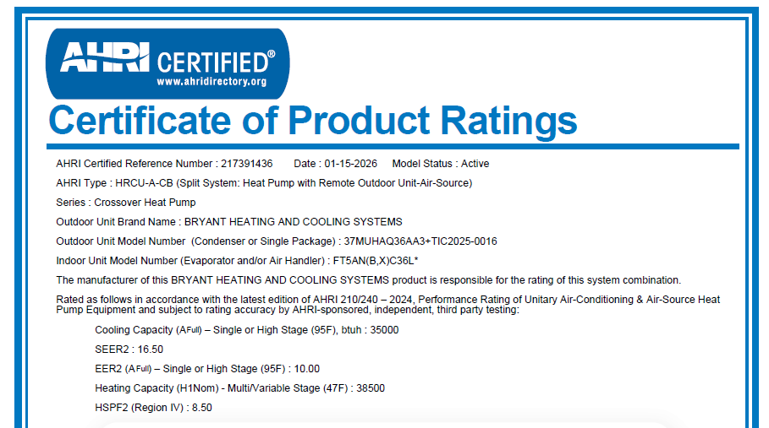
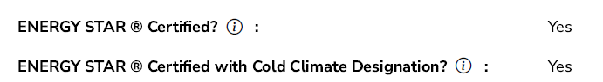
TECHNICAL CERTIFICATIONS
AHRI Certificate Confirms:
SEER2
EER2
HSPF2
AHRI Directory Confirms:
ENERGY STAR Certified
Cold Climate Designation

Slide 24
Retrofit Measure Requirements
 | Energy Star® Mini Split Heat Pump
Residence Requirements | Electric Heating
Measure Eligibility | If existing unit is a heat pump, efficiency must be equal to or below 14 SEER and below 65,000 Btu/h.
Measure Requirements | Replacement units will be rated at 16 SEER2 or greater, HSPF2 8.5 or greater, and below 65,000 Btu/h. Heat pump replacement will be completed by properly certified personnel (HVAC-licensed individual on staff). Existing heat pump will be permanently removed from service. Heat pump warranty information will be left with the customer or apartment management organization. Exceptions may be approved on a case-by-case basis for homes with other heating and cooling source.
Limits | 1 per household
Required Post Install Documentation | ENERGY STAR & AHRI Certificate Post-installation photographs of new indoor and outdoor units and nameplates New heat pump cooling capacity (tons) New heat pump heating capacity (tons) New heat pump efficiency (SEER and HSPF) Final Invoice: breakdown of material, labor, and admin costs Admin costs broken into the following buckets (may not all be applicable): HVAC contractor management Overhead eSuite Entry/Paperwork Transportation *Admin costs may not exceed 15% of total project cost for single-family projects, or 12.5% in multi-family projects
Notes:
*Add post install required documentation

Slide 25
Retrofit Measure Requirements
 | Energy Star® Heat Pump Water Heater
Residence Requirements | Electric Water Heating
Measure Eligibility | Existing primary water heater must be operational or in need of minor repairs and have been manufactured 5 years or more prior to the current calendar year. Majority of manufactured homes will not qualify for a heat pump water heater due to space and clearance requirements. There may be exceptions where a "ducted" heat pump water heater can be installed OR if the heat pump water heater is relocated to where there is enough clearance space for the unit to be installed. Contractors need to clearly show that the proposed system can be installed, meeting the manufacturer's technical specifications and requirements.
Measure Requirements | Replacement unit will be Energy Star certified and based on household size, not on existing water heater capacity.
Limits | 1 per household
Required Post Install Documentation | Final invoice & install date ENERGY STAR Certificate Installed unit manufacturer Installed unit model number Installed unit tank size Installed unit UEF rating Post-installation photographs of new unit and nameplate

Slide 26
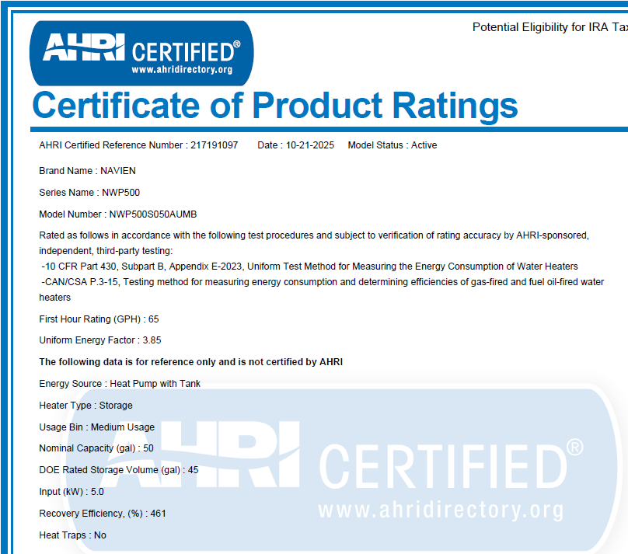
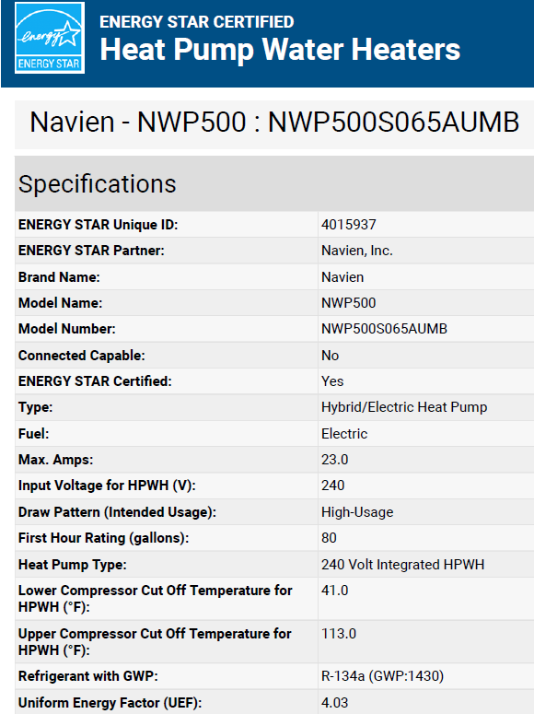
TECHNICAL CERTIFICATIONS

Slide 27
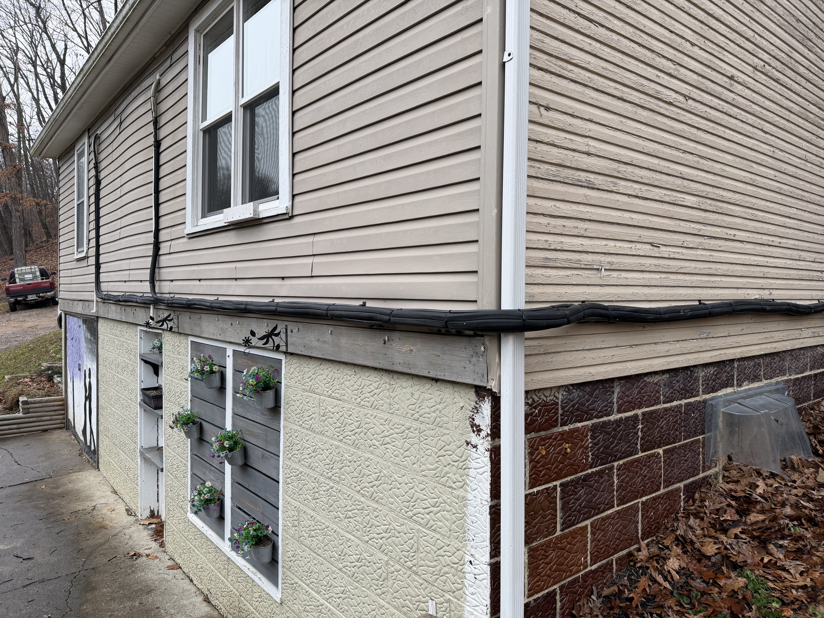
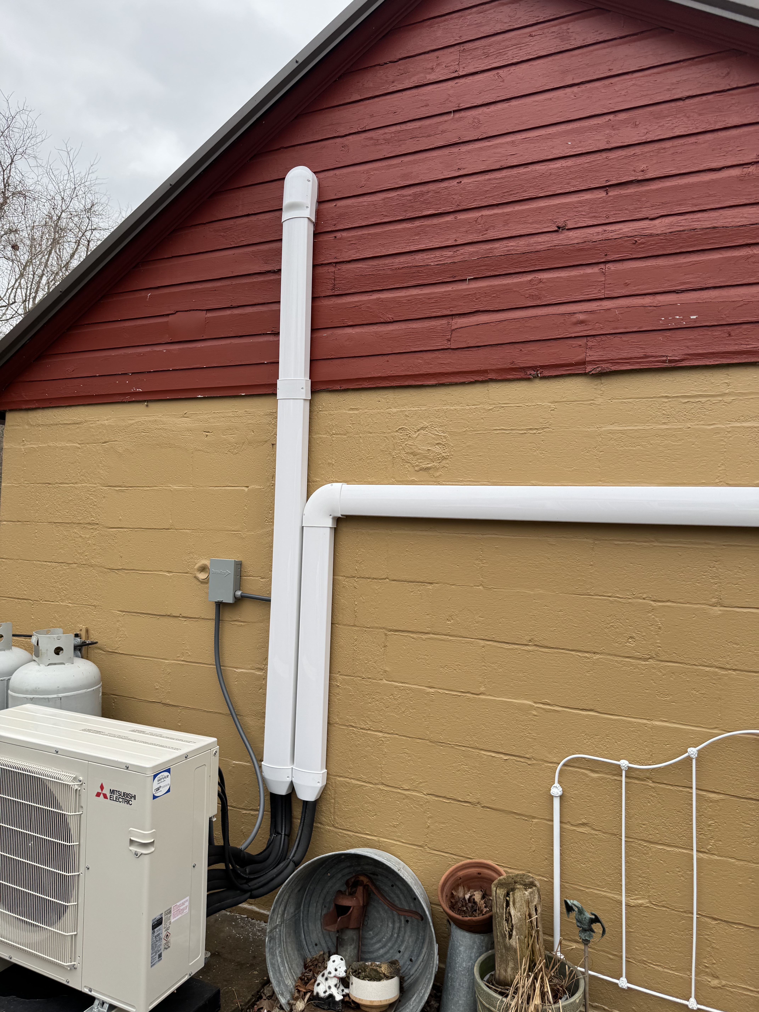
Best Practices
Not Acceptable
Acceptable

Slide 28
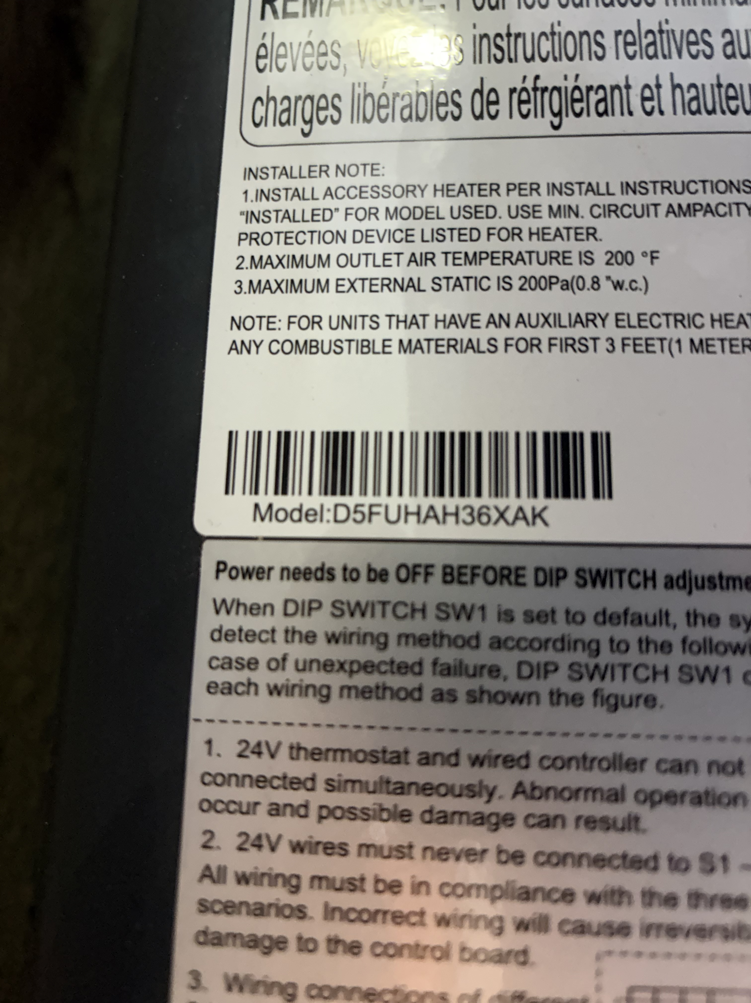
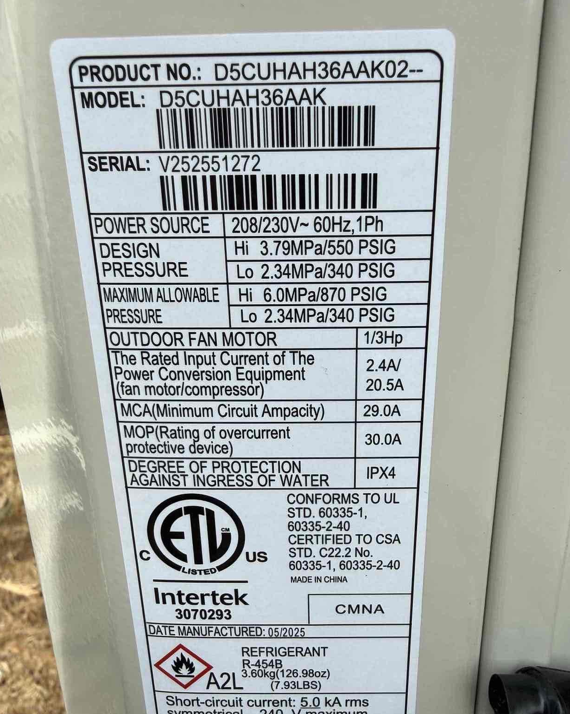
Best Practices
Not Acceptable
Acceptable

Slide 29
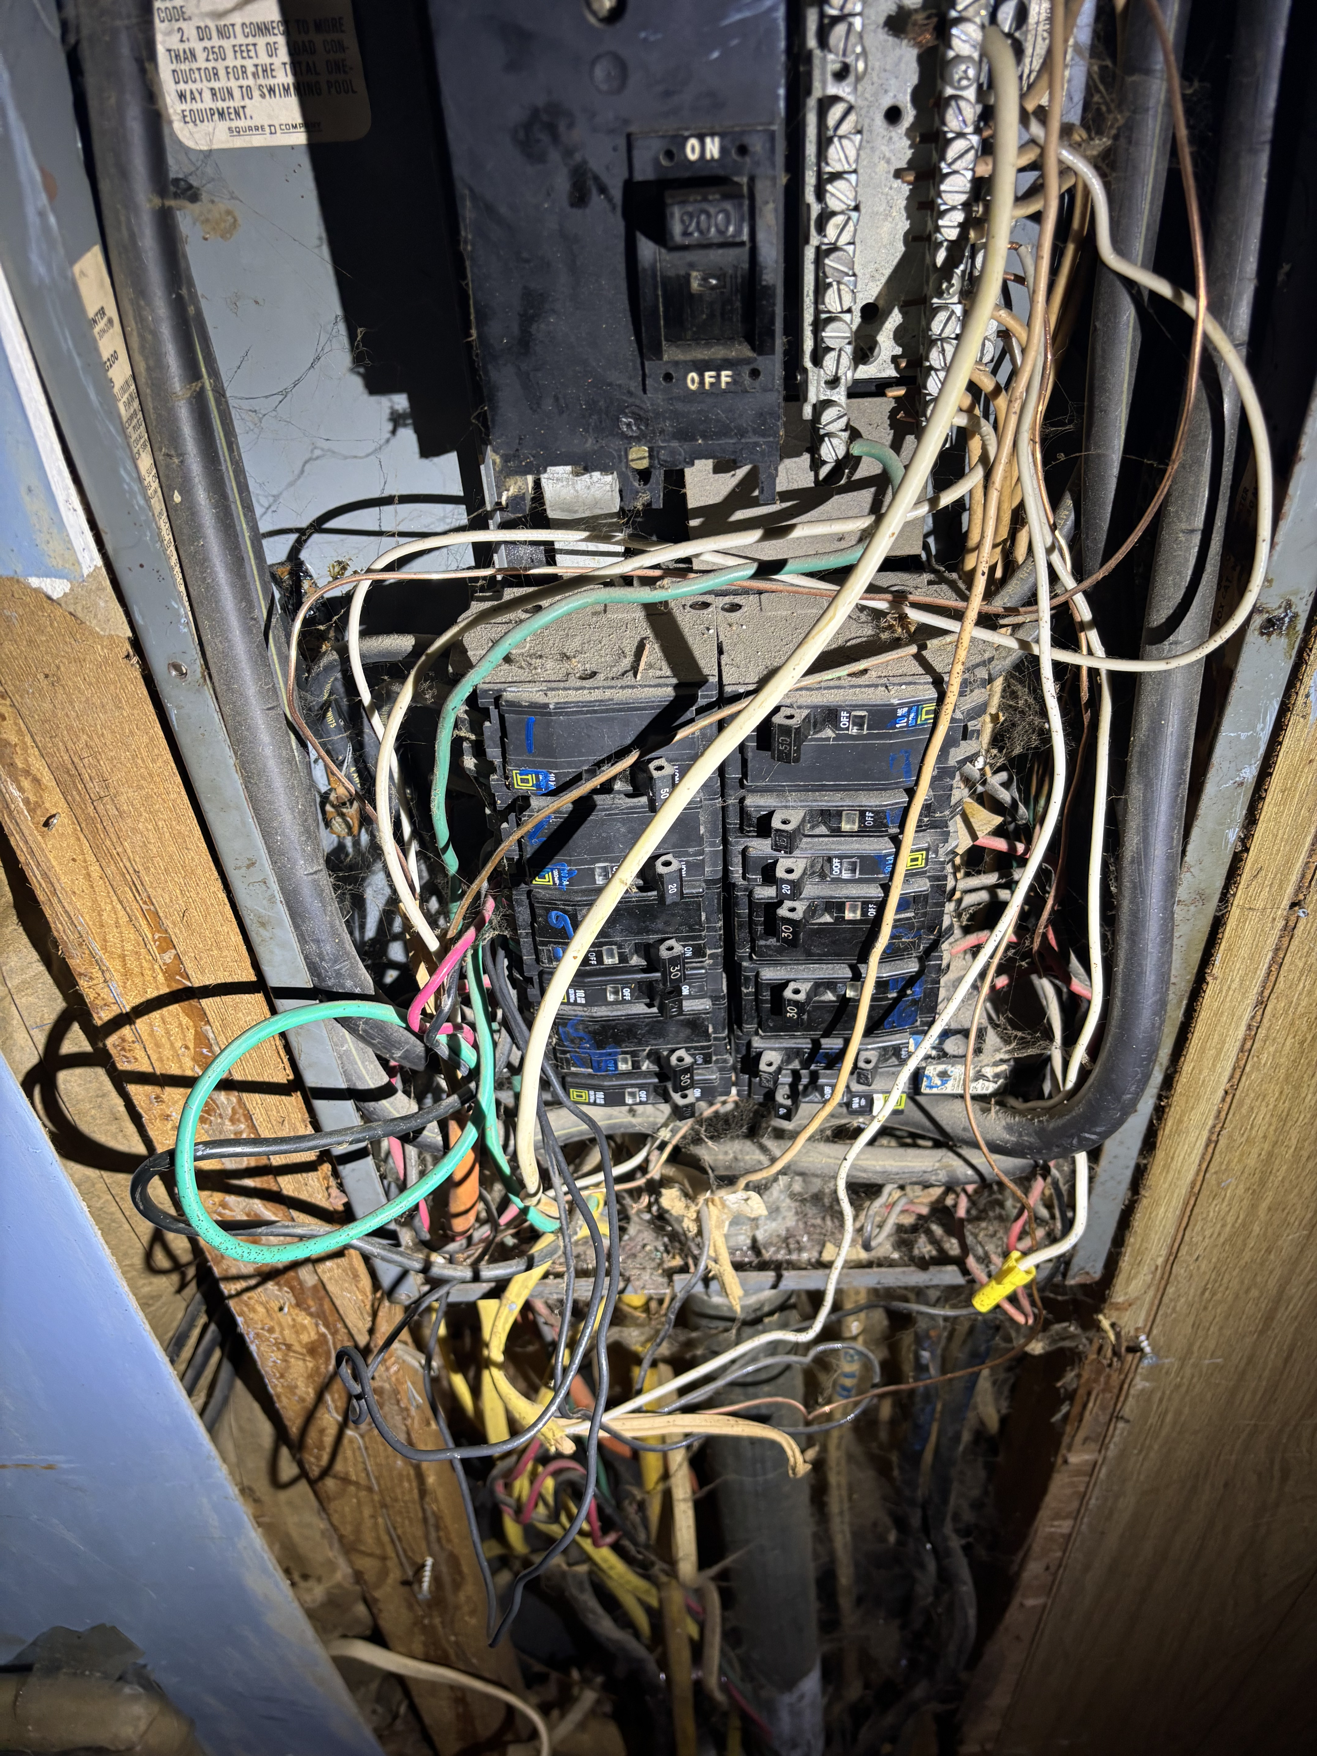
HEALTH/SAFETY - ELECTRIC PANELS
Health/Safety Items:
Must be related to an approved measure
Estimate of Work must be provided separately from requested measure(s)
EXAMPLES – APPROVED:
Electrical Panel Upgrades
Insect Infestation in HVAC Electric Panel
EXAMPLES – NOT APPROVED:
Plumbing Connections for Refrigerators – Ice-makers
Burst Pipes in Basements
Manufactured Home – Skirting Repairs

Slide 30
MEASURE REQUIREMENTS: WEATHERIZATION
INSULATION
AIR SEALING
DUCT SEALING
Notes:
Tim to present this section

Slide 31
Project Workflow – Weatherization
Customer Submits Application
Application Review & Approval
Inspection of Completed Project
Home Energy Assessment
Program Issues Payment
Identifies Eligible Retrofit Measures
Review & Pre-Approval of Measure(s)
Program Reviews & Approves
Installs DI Measures
Assigns Project to Contractor
Develops & Submits Project
Scope of Work
Reviews & Approves Project for Installation
Installs Measure(s) & Submits Completed Project Data
Resource Innovations
HELP Home Energy Assessor
Weatherization Contractor

Slide 32
RETROFIT MEASURE INCENTIVES
Retrofit Measure Name | Unit | Measure Cost | Labor Cost | CAP Incentive per Unit (100% of Cost) | SLP Incentive per Unit (65% of Cost)
Home that has air sealing performed | ∆100 CFM | $300.00 |  | $300.00 | $195.00
Sealed duct in unconditioned spaces* | ∆25 CFM | $200.00 |  | $200.00 | $130.00
Attic insulation | 100 SQ FT | $200.00 |  | $200.00 | $130.00
Floor insulation** | 100 SQ FT | $400.00 |  | $400.00 | $260.00
Wall insulation | 100 SQ FT | $300.00 |  | $300.00 | $195.00
Basement / sidewall insulation | 100 SQ FT | $200.00 |  | $200.00 | $130.00
Rim joist insulation | 100 SQ FT | $450.00 |  | $450.00 | $292.50
*Duct Sealing will receive an $800 minimum incentive for projects reducing less than 100 CFM
** Does not include mobile home belly insulation

Slide 33
Air Sealing
 | Air Sealing
Residence Requirements | Electric Space Heating | Electric Cooling System (Central AC, Room AC, or Heat Pumps)
Measure Requirements | Air sealing is only eligible when additional mechanical ventilation is not required for compliance with current ASHRAE Standard 62.2. Mechanical ventilation costs are not covered by the program. If air sealing cannot be completed due to the need for additional mechanical ventilation to meet ASHRAE 62.2 requirements, the project will be considered a non-project. Air sealing will be completed by properly certified personnel (BPI or equivalent). All accessible areas of the attic, floor, and exterior penetrations will be sealed. Pre- and post-blower door tests will be performed on all air-sealed units. In single family homes, air sealing should be performed in conjunction with the attic insulation measure if existing insulation is insufficient. In multifamily homes, air sealing is recommended to be performed in conjunction with attic insulation measures if existing insulation is insufficient, where applicable (i.e., in the topmost floors of qualifying homes).
Required Post Install Documentation | Pre- and post-installation photographs of the unit number or front of home, and illustrating actions taken: Air sealing around pipe penetrations, construction components Weather stripping around windows and doors Attic access cover Knee wall door insulation and air sealing Pre and post CFM blower door readings from pressure gauge Complete ASHRAE Calculator such as Red Calc ASHRAE 62.2-2016 Ventilation calculator and submit screenshot with submission.
Estimated SLP Customer Cost | The estimated SLP customer cost, after applying the measure rebate, ranges from $100 to $200 per 100 CFM reduced.
Notes:
Pre and post photos of area to be air sealed
Pre and post photos of manometer
Make sure to seal attic access
Use blower door directed air sealing
Check exterior doors and areas under sinks on exterior walls
Seal duct boots on mobile homes while doing air sealing
Don’t forget rim joist air sealing prior to insulating rim joist

Slide 34
Duct Sealing
 | Duct Sealing
Residence Requirements | Electric Space Heating | Central AC
Measure Requirements | Ducts will be sealed with mastic sealant or mastic tape in unconditioned spaces. Duct sealing will be completed by properly certified personnel (BPI or equivalent). Acceptable methods of duct leakage testing include: Preferred: Duct Blaster (CFM25) Optional: Modified Blower Door Subtraction Method (CFM50)
Required Post Install Documentation | Photo documentation of the pre and post duct sealing pressure readings. Duct Blaster: CFM25 pre and post, PA pre and post Modified Blower Door Subtraction Method: CFM50 Whole house pre and post, CFM50 Envelope pre and post, Duct PA pre and post
Estimated SLP Customer Cost | The estimated SLP customer cost, after applying the measure rebate, ranges from $50 to $100 per 25 CFM reduced.
Notes:
When sealing duct boots, mastic and fiberglass tape will be used to ensure proper sealing.
Make sure to allow mastic to dry completely before reinstalling vent cover

Slide 35
Basement / Sidewall Insulation
 | Basement / Sidewall Insulation
Residence Requirements | Electric Heating | Central AC | Basement
Measure Eligibility | Existing basement / sidewall insulation must be R-5 or less.
Measure Requirements | Total installed insulation will be R-15 or greater. Insulation type will be fiberglass, cellulose, foam board or spray foam.
Required Post Install Documentation | Pre- and post-installation photos showing the following: Exterior image of unit number on apartment door/wall or front of home Document existing insulation R-value Document existing square footage of area insulated If possible, basement/sidewall interior space with no insulation or with damaged insulation If possible, installed insulation Document new insulation bag/label with legible R-value Document new square footage of area insulated
Estimated SLP Customer Cost | The estimated SLP customer cost, after applying the measure rebate, ranges from $50 to $100 per 100 square feet insulated.
Notes:
Pre and post photos of area to be insulated
Photos of information on material being installed
insulation bags, batts, spray foam or foam board

Slide 36
Rim Joist Insulation
 | Rim Joist Insulation
Residence Requirements | Electric Heating | Central AC
Measure Eligibility | Existing rim joist insulation must be R-5 or less.
Measure Requirements | Total installed insulation will be R-20 or greater. Insulation type will be fiberglass, cellulose, or spray foam.
Required Post Install Documentation | Pre- and post-installation photos showing the following: Exterior image of unit number on apartment door/wall or front of home Document existing insulation R-value Document existing square footage of area insulated If possible, areas with no insulation or with damaged insulation along the rim joist If possible, installed insulation Document new insulation bag/label with legible R-value Document new square footage of area insulated
Estimated SLP Customer Cost | The estimated SLP customer cost, after applying the measure rebate, ranges from $100 to $200 per 100 square feet insulated.
Notes:
Air sealing needs to be completed before Rim Joist insulation is installed
Pre and post photos of rim joist area to be insulated

Slide 37
Floor Insulation
 | Floor Insulation
Residence Requirements | Electric Heating | Central AC | Crawl Space
Measure Eligibility | Existing floor insulation must be R-5 or less. Belly insulation for manufactured homes is not eligible
Measure Requirements | R-19 batt insulation will be applied to the underside of the floor. Floor insulation will only be installed when the floor separates conditioned and unconditioned spaces. Batts will be neatly installed, fitting tightly together at joints, fitting closely around obstructions, and filling all the space within the floor cavity. Batts will be cut accurately and squarely and installed in continuous contact with the subfloor. Hanging batts risk non-payment until corrected. Batts will be supported by twine, wire, wood lath, or lighting rods/tiger teeth (friction fit method is not acceptable for fiberglass batts). Fasteners for floor insulation will resist gravity, the weight of insulation, and the potential for moisture condensation.
Required Post Install Documentation | Pre- and post-installation photos showing the following: Exterior image of unit number on apartment door/wall or front of home Document existing insulation R-value Document existing square footage of area insulated Crawl space with no insulation or crawl space with damaged insulation Installed insulation Document new insulation bag/label with legible R-value Document new square footage of area insulated
Estimated SLP Customer Cost | The estimated SLP customer cost, after applying the measure rebate, ranges from $100 to $200 per 100 square feet insulated.
Notes:
Pre and post photos of area to be insulated
Photos of information on insulation batts
** Mobile home bellies are eligible for repair, replacement on insulation install

Slide 38
Wall Insulation
 | Wall Insulation
Residence Requirements | Electric Heating | Central AC
Measure Eligibility | Multi-family home projects may be reviewed on a case-by-case basis. Existing wall insulation must be R-5 or less.
Measure Requirements | Total installed insulation will be R-13 or greater. Only exterior walls are eligible or walls separating conditioned and unconditioned spaces. Insulation type will be fiberglass, cellulose, or spray foam.
Required Post Install Documentation | Pre- and post-installation photos showing the following: Exterior image of unit number on apartment door/wall or front of home Document existing insulation R-value Document existing square footage of area insulated If possible, wall interior space with no insulation or with damaged insulation If possible, installed insulation Document new insulation bag/label with legible R-value Document new square footage of area insulated
Estimated SLP Customer Cost | The estimated SLP customer cost, after applying the measure rebate, ranges from $100 to $200 per 100 square feet insulated.
Notes:
Pre and Post photos of area to be insulated
Photos of information on Insulation Bags

Slide 39
Attic Insulation
 | Attic Insulation
Residence Requirements | Electric Heating | Central AC
Measure Eligibility | Existing attic insulation must be R-19 or less.
Measure Requirements | Total installed insulation will be R-49 for homes with electric space heating. Insulation type will be fiberglass or cellulose.
Required Post Install Documentation | Pre- and post-installation photos showing the following: Exterior image of unit number on apartment door/wall or front of home Document existing insulation R-value Document existing square footage of area insulated Attic space with no insulation or with damaged insulation Installed insulation Document new insulation bag/label with legible R-value Document new square footage of area insulated
Estimated SLP Customer Cost | The estimated SLP customer cost, after applying the measure rebate, ranges from $70 to $100 per 100 square feet insulated.
Notes:
Air sealing needs to be completed before attic insulation is installed
Pre and post photos of area to be insulated
Photos of information on insulation bags
Install rulers
Install certificate of insulation

Slide 40
Program Best Practices
Notes:
Dave to present

Slide 41
Best Practices
Customer Engagement
  Educate the customer on new equipment operation, key features, and basic maintenance.
  Leave all manuals and documentation for installed equipment
  Review warranty information including coverage details
  Provide contact information for follow-up questions, service, or support.
Quotes & Final Invoices
  Provide a clear, itemized quote outlining each piece of equipment and scope of work, with associated costs for each line item (equipment, labor, materials, etc.).
  Include detailed descriptions of the work to be performed to ensure full transparency.
  Specify exact equipment make and model numbers being proposed.
  Include documentation showing the equipment meets ENERGY STAR® requirements (if applicable).
  Provide a final invoice upon completion that mirrors the approved quote, with all line items and costs clearly detailed.
  Ensure the final invoice includes the installation date and any updates or changes from the original scope of work.
Walkaway Situations
  In unsafe situations, assessors/contractors should use their discretion to walk away if they feel threatened or the environment is hazardous (e.g., aggressive behavior, pets, gas leaks, mold, excessive clutter).
  If work cannot be safely completed, inform the client on-site and follow up with written documentation to both the customer & the program team. If the customer can remedy the walkaway issue, the assessor/contractor may return and complete the work.

Slide 42
Important Reminders
Arrive on time for all scheduled appointments
Dress appropriately and maintain a clean, professional appearance
Represent the program in a respectful and professional manner at all time
Bring all necessary tools and materials to perform installs efficiently
Have a reliable method to record and capture measure data (e.g., computer, phone, paperwork)
Communicate clearly and respectfully with customers
Follow safety protocols and use discretion in unsafe situations
Document and report any barriers to completing work

Slide 43
Program Payments
Notes:
Dani to cover this section

Slide 44
Payment Timeline
Batch payments are submitted on a weekly basis.​
Payments are processed under NET-15 terms, allowing up to 15 days for review from the initial submission date.​
Once approved, funds are issued via ACH, which typically takes a few additional business days.​
Overall, incentive payments are expected to be received within approximately 4–6 weeks from the date the project is approved in eSuite.​

Slide 45
PROGRAM RESOURCES
Notes:
Dani to cover this section

Slide 46
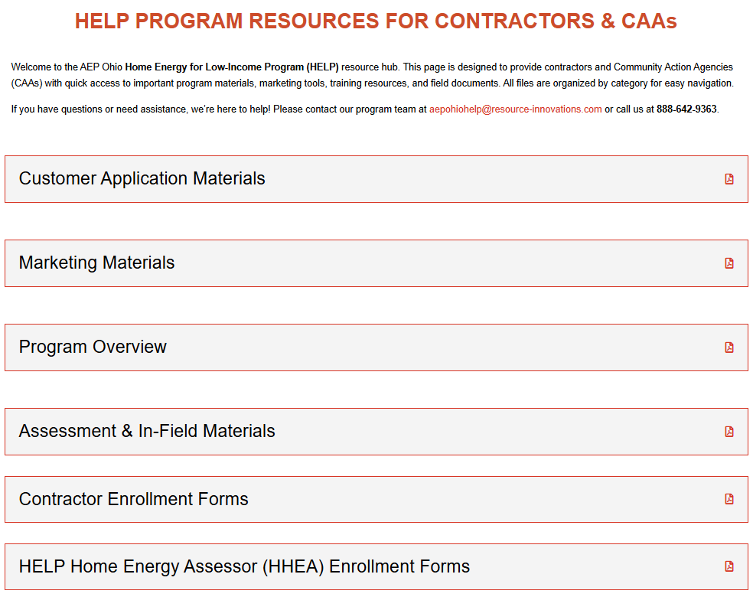
Resource Hub
The Resource Hub serves as a centralized location for all HELP program materials and reference documents used by HELP Home Energy Assessors (HHEAs) and Installation Contractors.
The Resource Hub can be accessed via the following link:
HELP Resource HUB | aepohhelp

Slide 47

QUESTIONS?
Questions?

Slide 48
THANK YOU FOR JOINING US TODAY!

